Slide 1

EVERYONE DEVELOPER

Slide 2
PROBLEM STATEMENT
The Education Department Govt of Sikkim, every year conducts the STET (State Teacher Eligibility Test) exam for all categories of teachers Primary Teacher, Graduate Teacher and Post Graduate Teacher before the recruitment exam. All the eligible candidates will apply for STET, so the applicants will be almost 5000. Checking all the documents, verifying them and issuing admit cards to individual candidates manually is a difficult job, which we have been carrying for many years. During this span of time we made human error and had to repeat the processes. What we want : To make the STET exam error free and quick solution, we are in need of online software or a window where candidates can login, register, fill the form and submit. Software should keep bio data of the candidate, print admits cards and later we can display online results of STET as well. During all the process automatic SMS and Email facilities should be included. Mobile app will be more convenient along with software. Challenges Network connectivity is not uniform all throughout the state of Sikkim so software should be developed in such a way that it can run with less network ,that is it can open only that window which candidate wants. Design an application that integrates with some reliable system like DigiLocker for verification of documents, or accept documents signed by DigiLocker eSign for document verification. Reduce manual intervention wherever possible, manual verification should be done only when the final offer letter is to be issued.

Slide 3
REQUIREMENTS OF PROBLEM STATEMENT
A platform that will make the STET exam error-free and quick solution.
A web portal platform where all the eligible candidates can apply for the STET exam.
A window where the candidate can register, login, fill the form, and submit.
A platform that will keep biodata of candidates, print admit cards and later results will be published online.
During all the processes automatic SMS and Email facilities will be provided to the candidates.
A platform that will inform candidates about their respective exams for all categories of teacher Primary Teacher, Graduate Teacher, and Post Graduate Teacher before the recruitment exam conducted by STET.
A software developed lightweight so that it can run with less network.

Slide 4
USE CASE
It will provide a single-window platform where candidates can register, login, fill the form, and submit.
Informative for the candidates to know about the information related to exams.
It will work as a representative for all the exams organized by the Education Department, Govt. of Sikkim for the candidates.
It will keep track of all past exams through Application History.
It will help in checking all the documents and issuing admit cards to an individual candidate.
It will reduce human-made errors and repetition in processes.
It will reduce manual Intervention during all the processes.
It will make STET Exam Error Free and Quick Solution.
It will display the online results of STET.
It will provide automatic SMS and Email facilities to all the candidates.
It will load only that window which the candidate wants.
On-demand loading reduces time consumption and memory usage thereby Optimizing content delivery.
The user’s experience will be enhanced as the requested content is fed in no time.
Optimal Usage of time and space resources makes it a cost-effective approach from the point of view of the Education Department, Govt. Of Sikkim.
It can be adjusted according to the device in hand i.e Responsive User Interface.
It can smoothly run with less network and will overcome the challenges of Non-Uniformity in Network Connectivity.

Slide 5
TECHNICAL SPECIFICATIONS
Angular
Angular material
Node JS
Technology Stack
Mongo DB
Loop Back Explorer

Slide 6
NOW SAMPLE OF OUR
STET WEBSITE
CONTINUES

Slide 7
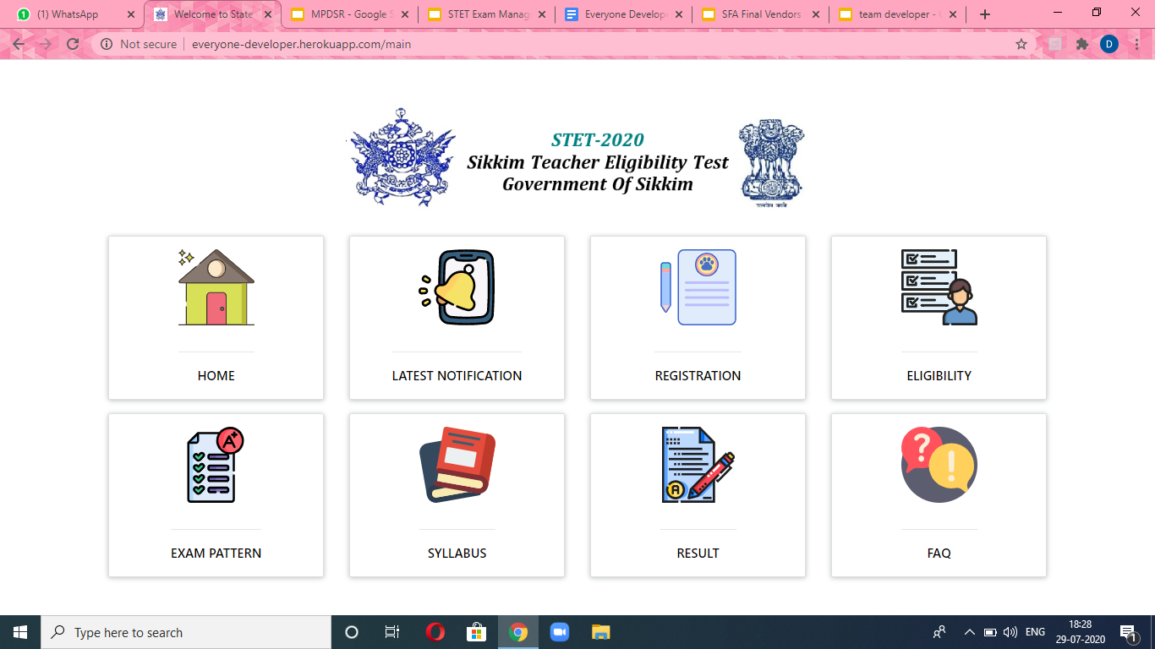
SAMPLE UI OF OUR WEBSITE

Slide 8
7 MAIN MODULES
5. REGISTRATION
4. RESULT
3. ELIGIBILITY
6. CANDIDATE PORTAL
WEBSITE
7. CONTACT US
2. EXAM PATTERN
HOME
SYLLABUS
FAQ
LATEST NOTIFCATION

Slide 9
HOME

Slide 10
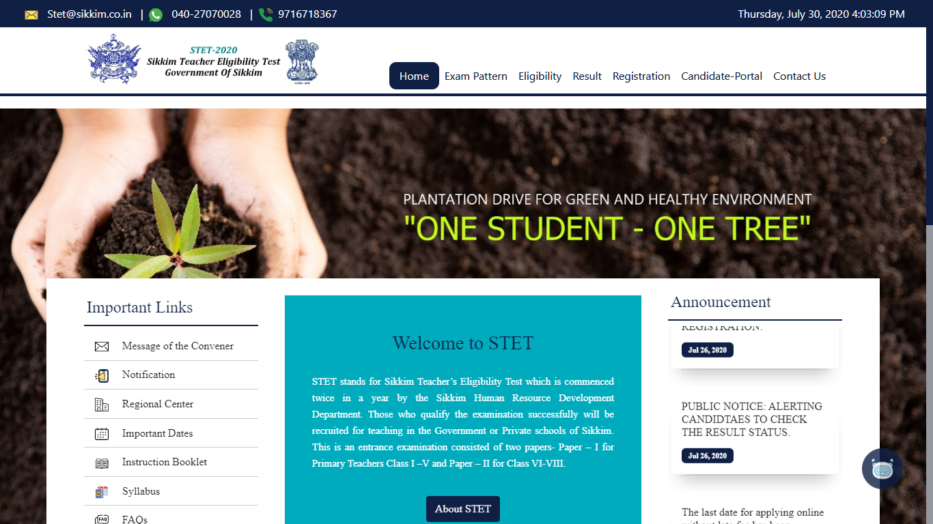
SAMPLE VIEW OF HOME SCREEN

Slide 11
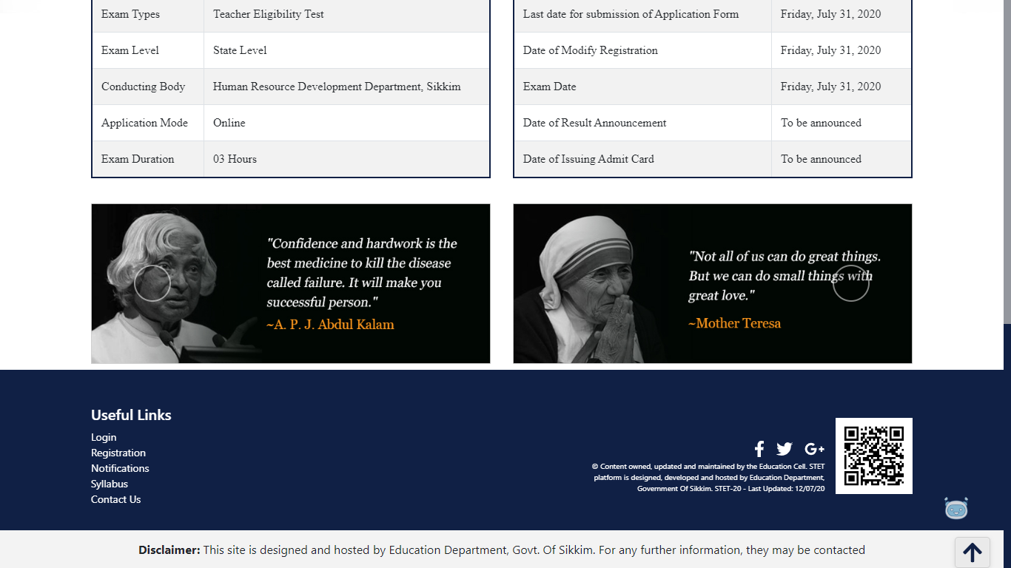
SAMPLE VIEW OF HOME SCREEN

Slide 12
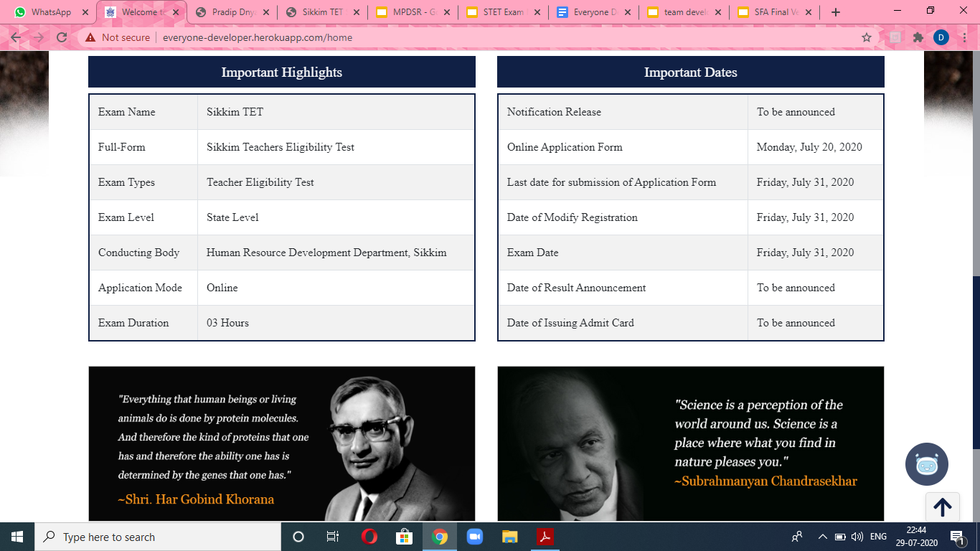
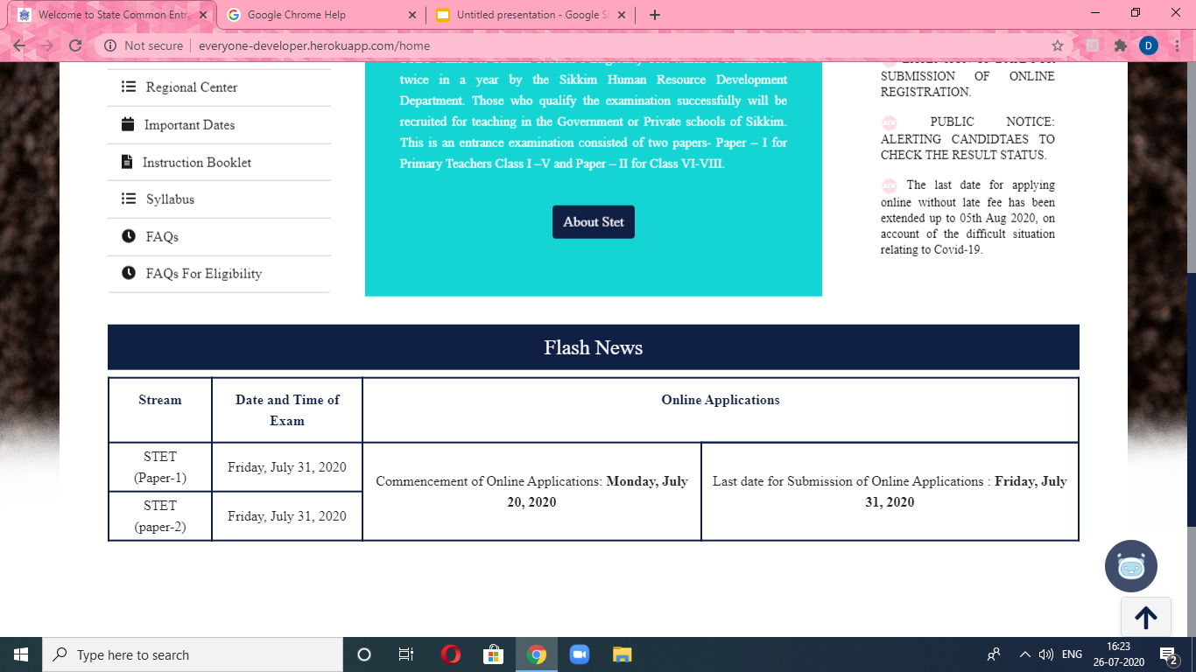
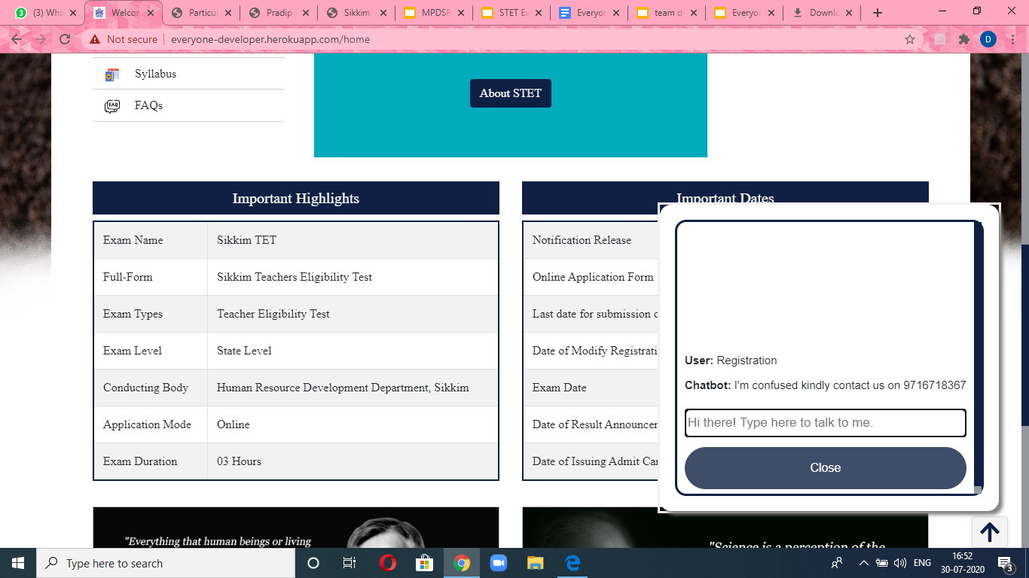
AN EXTRA FEATURE IN OUR WEBSITE
CHATBOT

Slide 13
SYLLABUS

Slide 14
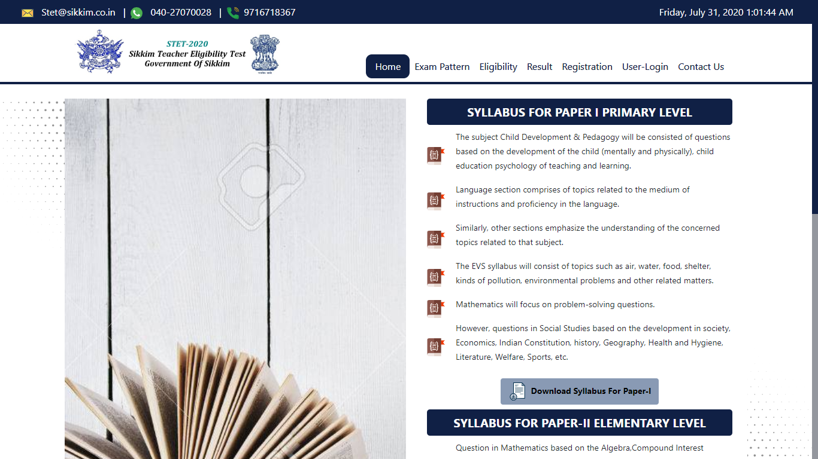
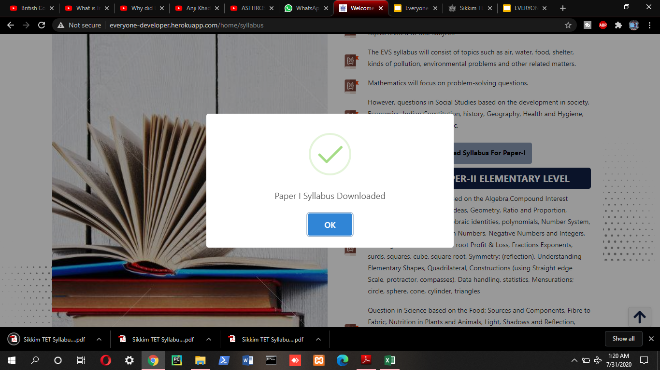
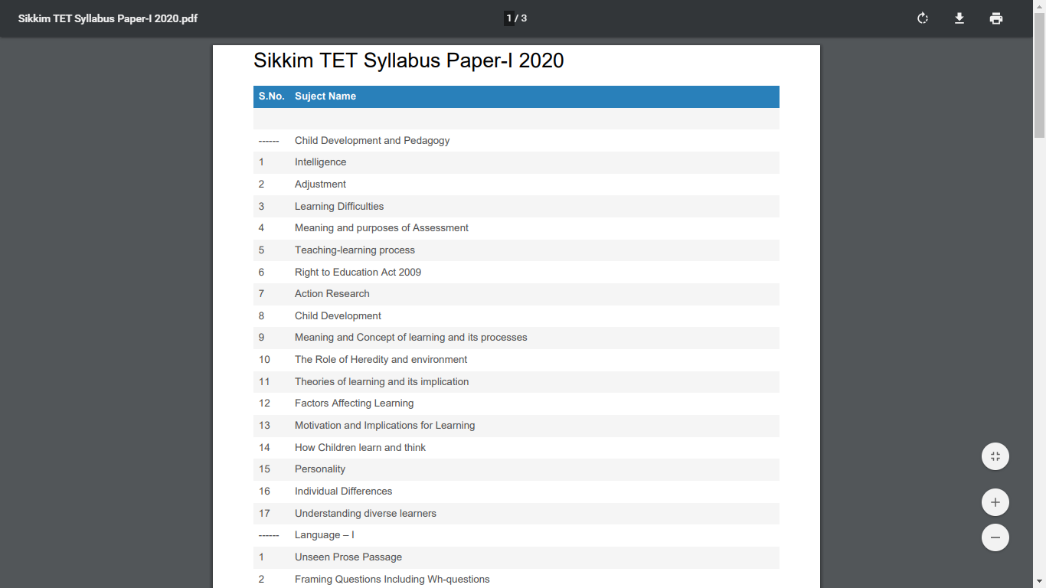
SYLLABUS
CLICK ON THE BUTTON

Slide 15
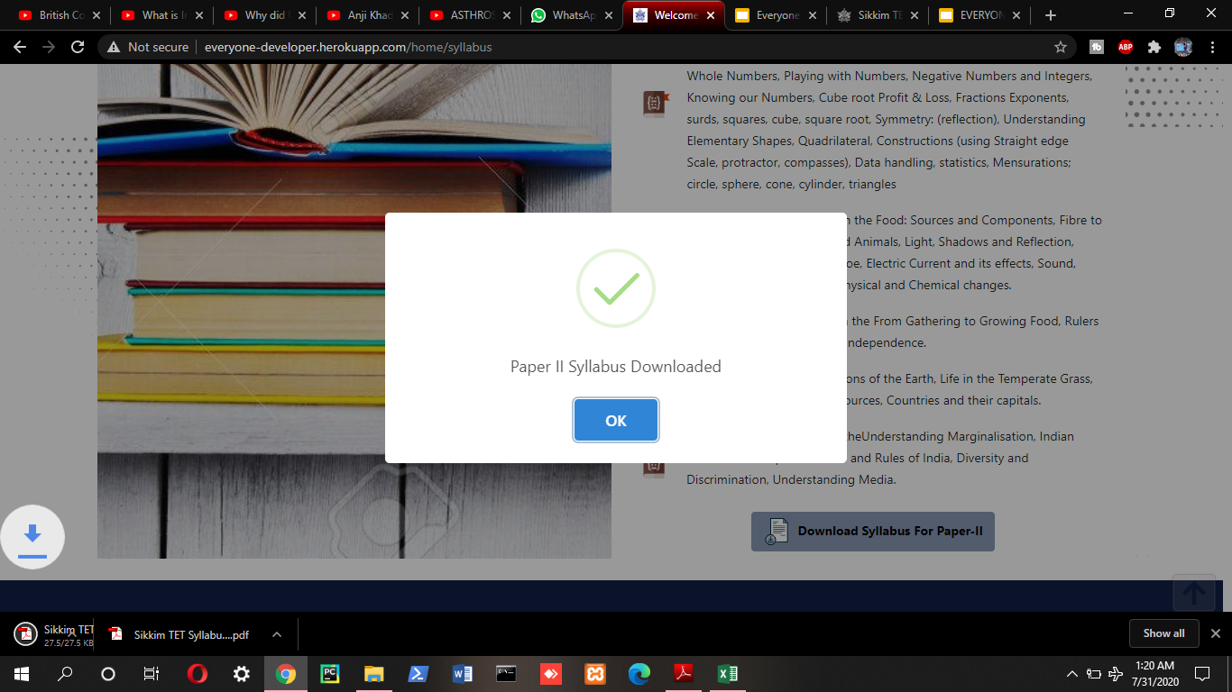
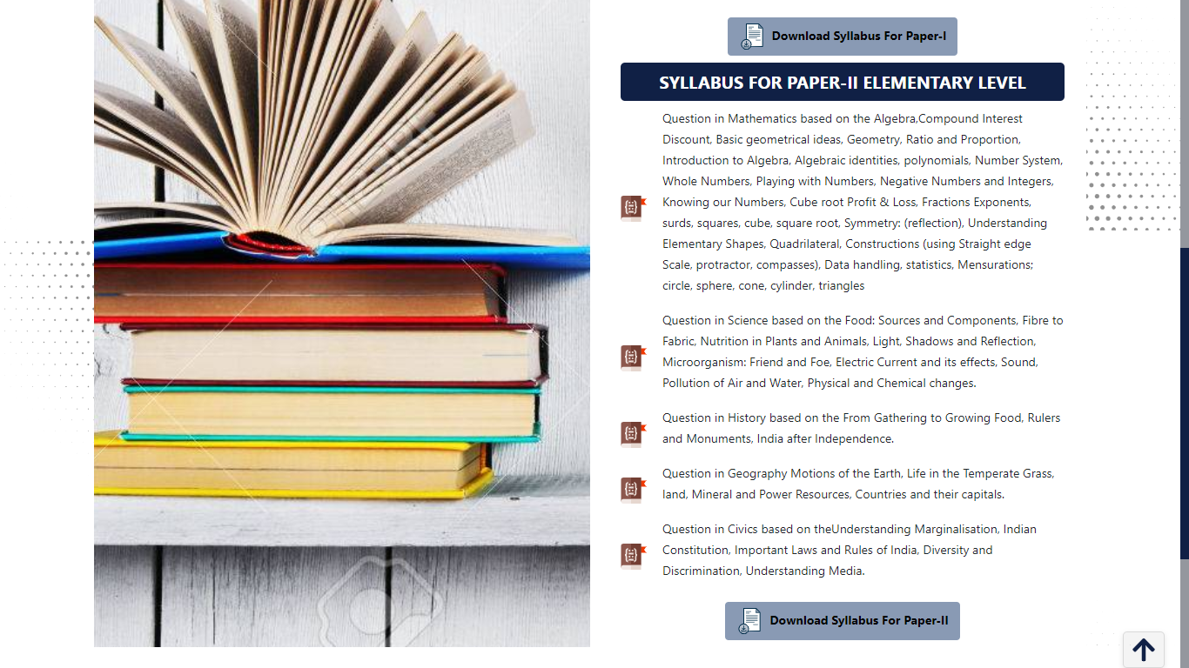
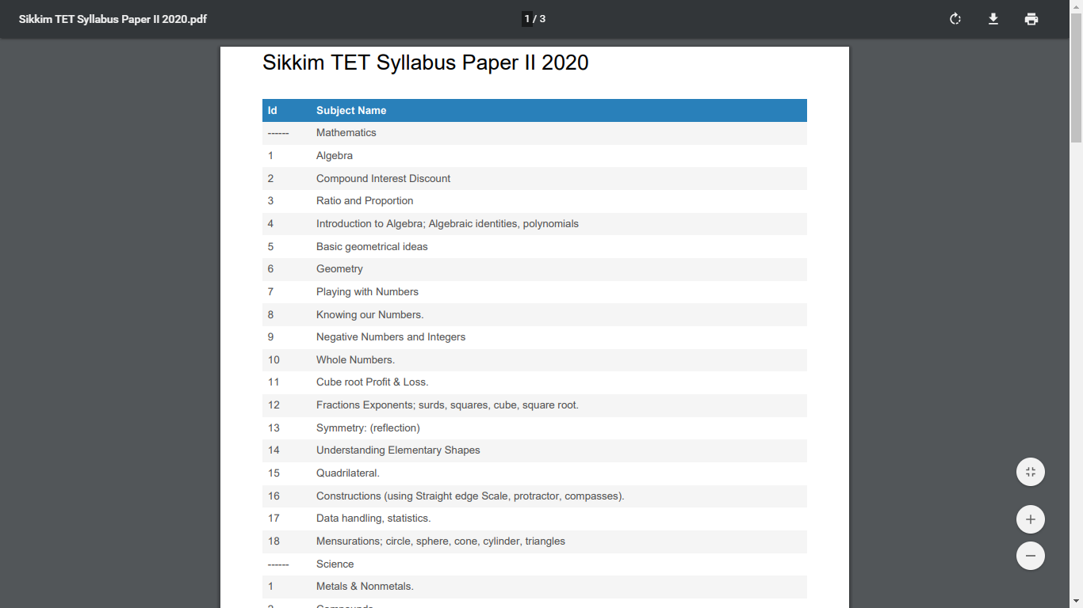
SYLLABUS
CLICK
ON
THE
BUTTON

Slide 16
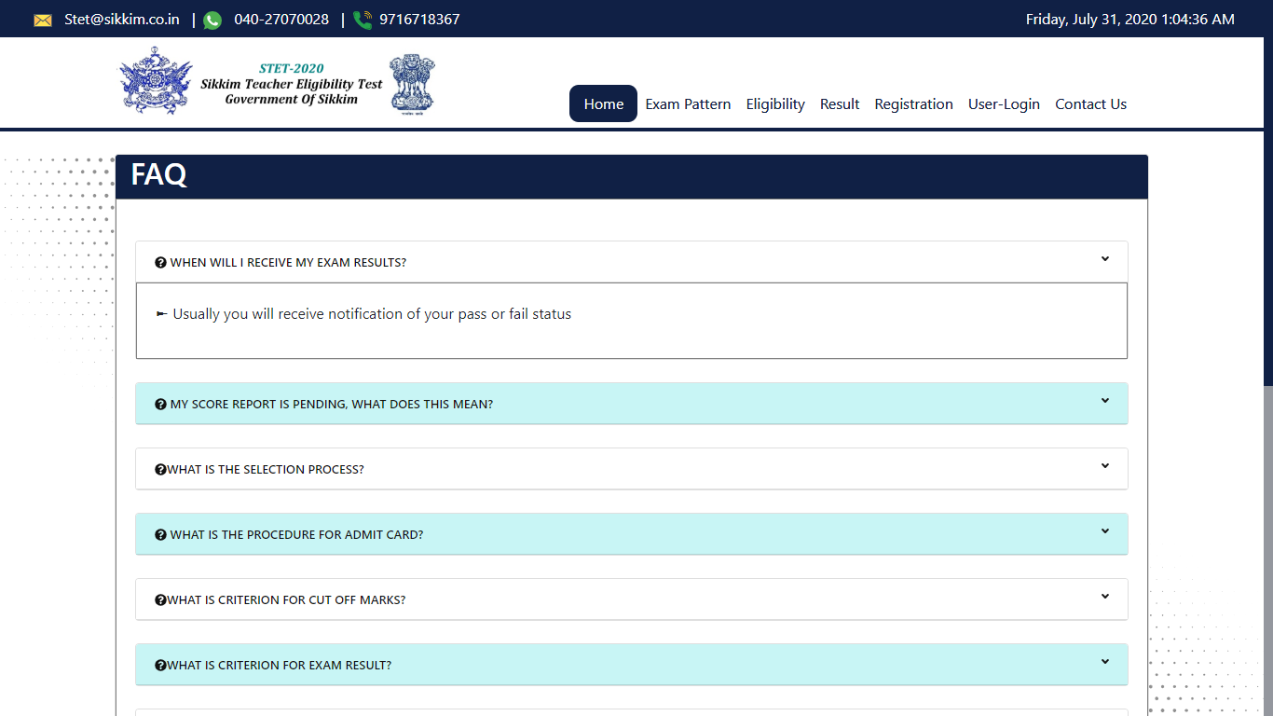
FAQ

Slide 17
EXAM PATTERN

Slide 18
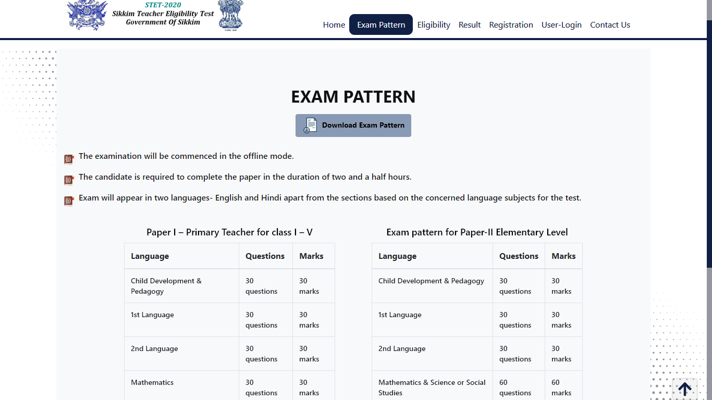
SAMPLE VIEW OF EXAM PATTERN

Slide 19
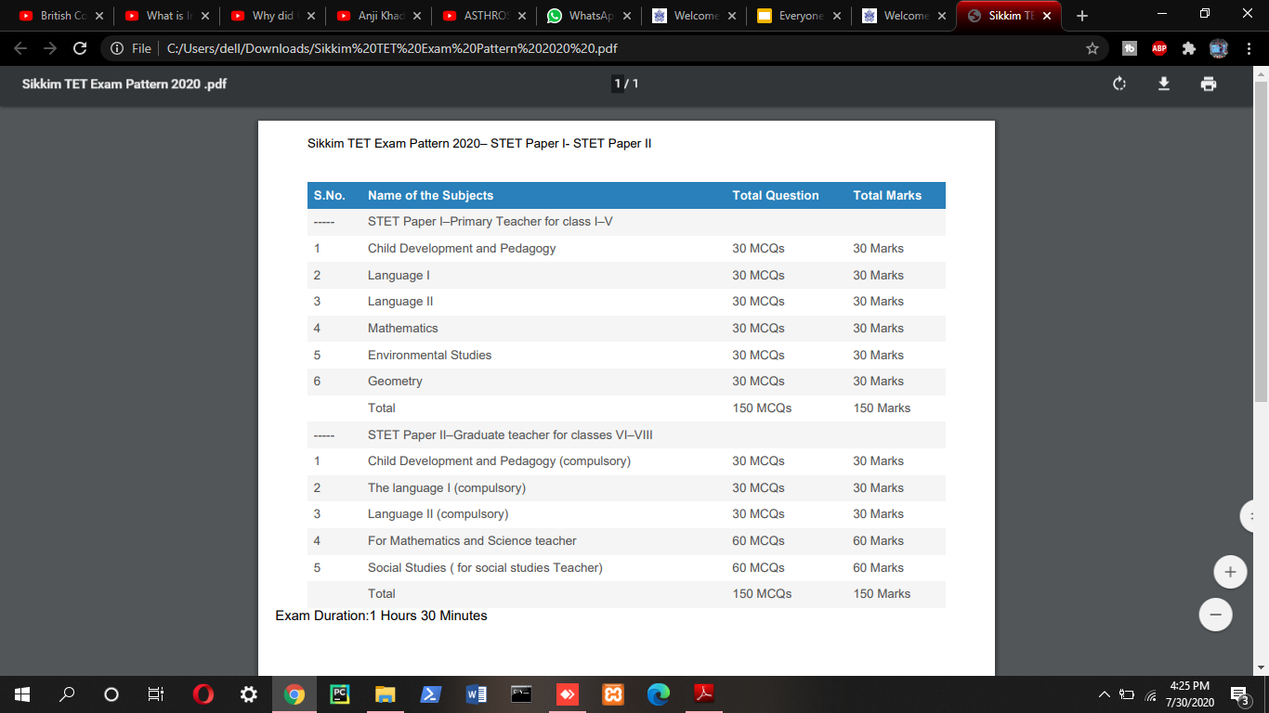
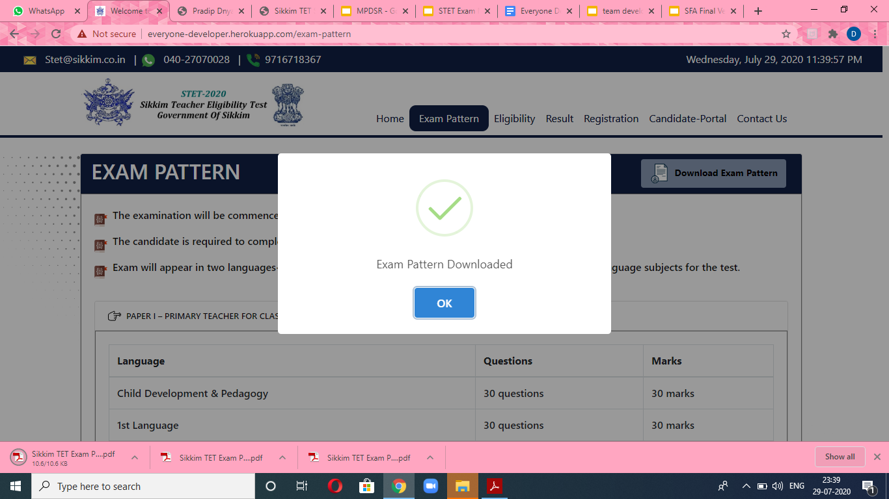
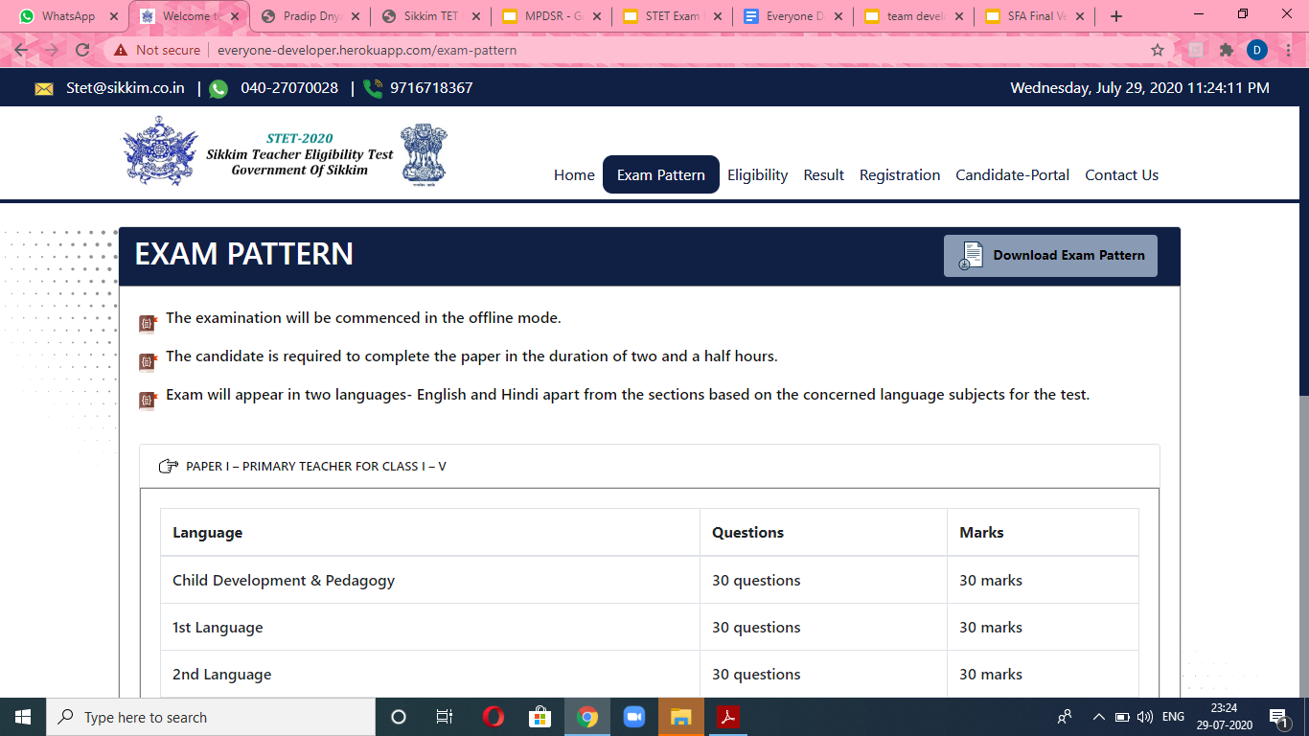
STEPS TO DOWNLOAD EXAM PATTERN
CLICK ON THE BUTTON

Slide 20
ELIGIBILITY

Slide 21
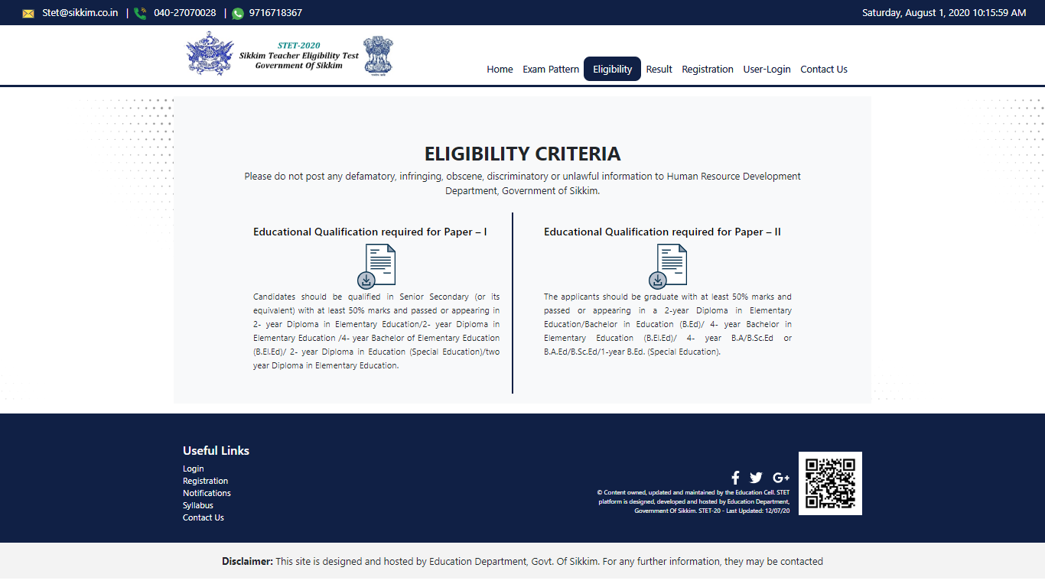
ELIGIBILITY

Slide 22
RESULT

Slide 23
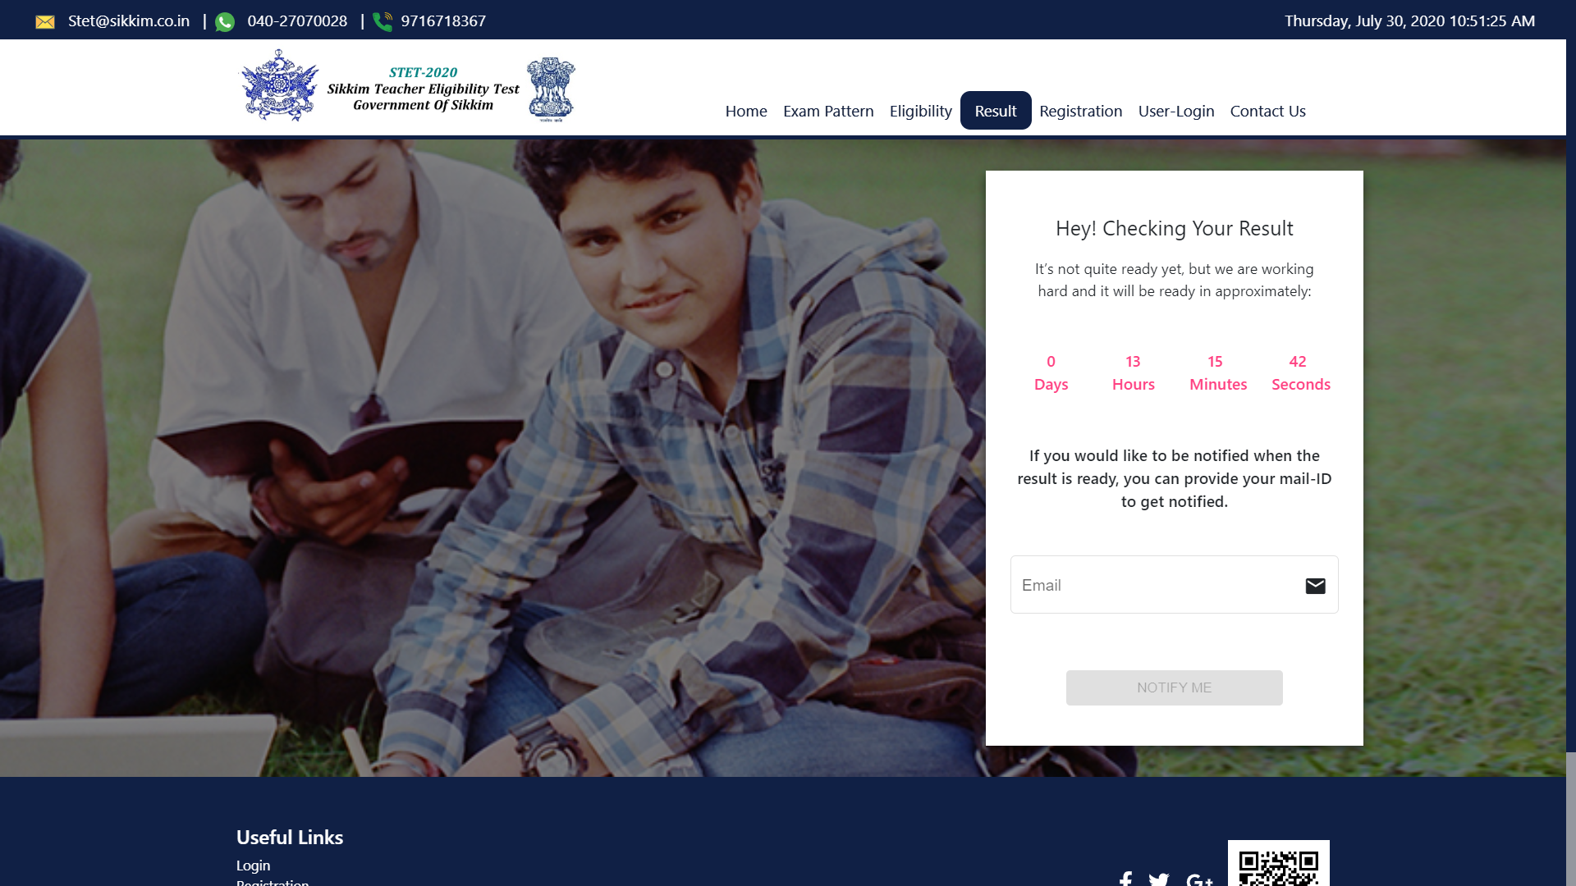
IF RESULT IS NOT ANNOUNCED
TIME COUNTER Is Provided To Inform The USER
User can give his Email Id and then mail is given when Result comes

Slide 24
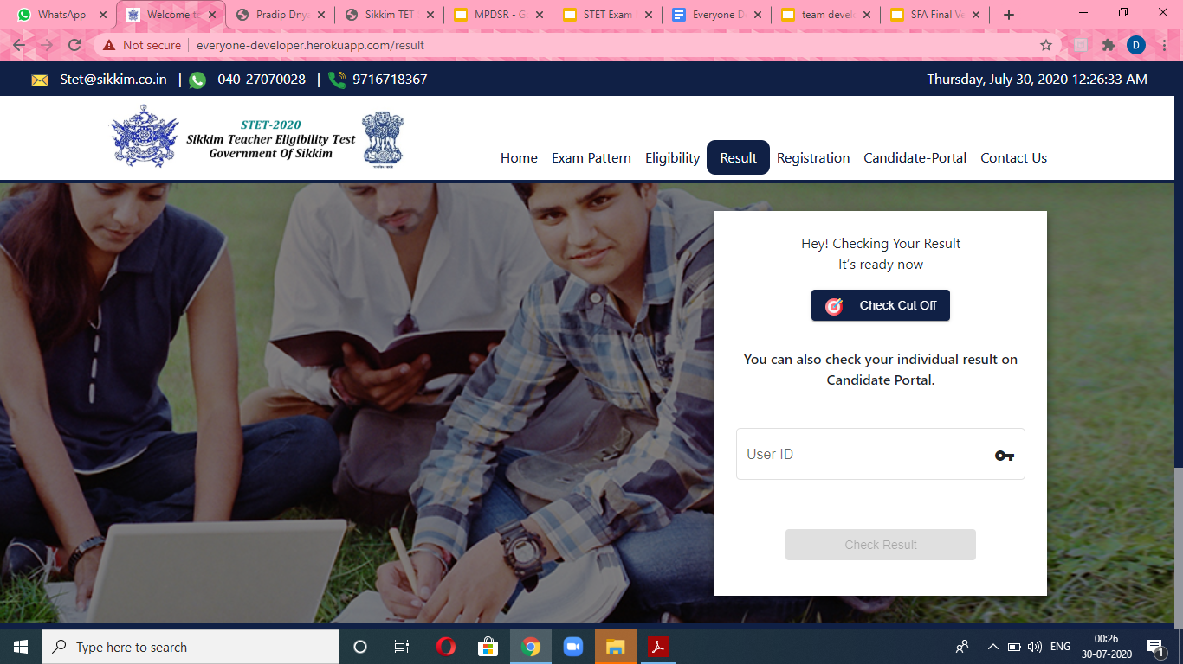
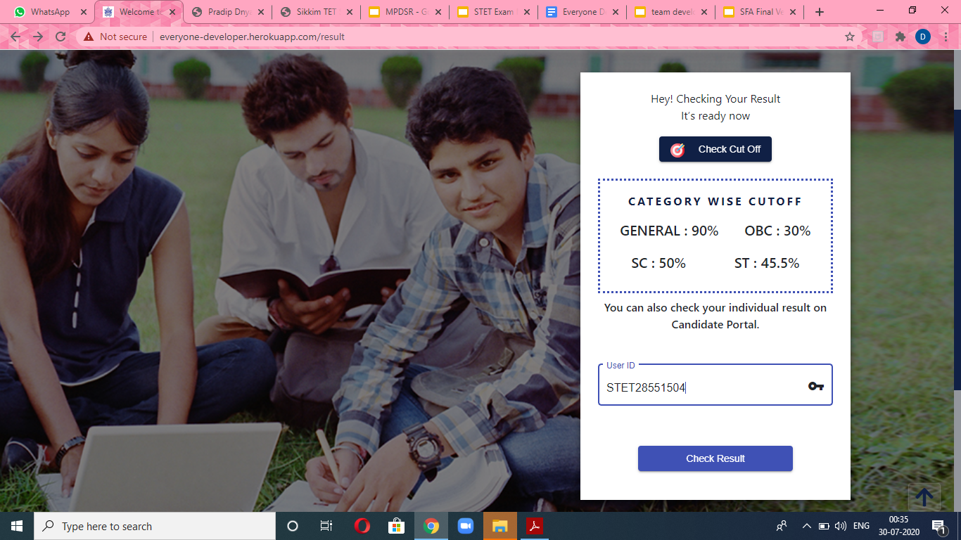
RESULT ANNOUNCED
INSERT YOUR USER ID
CLICK ON THIS BUTTON TO PROCEED

Slide 25
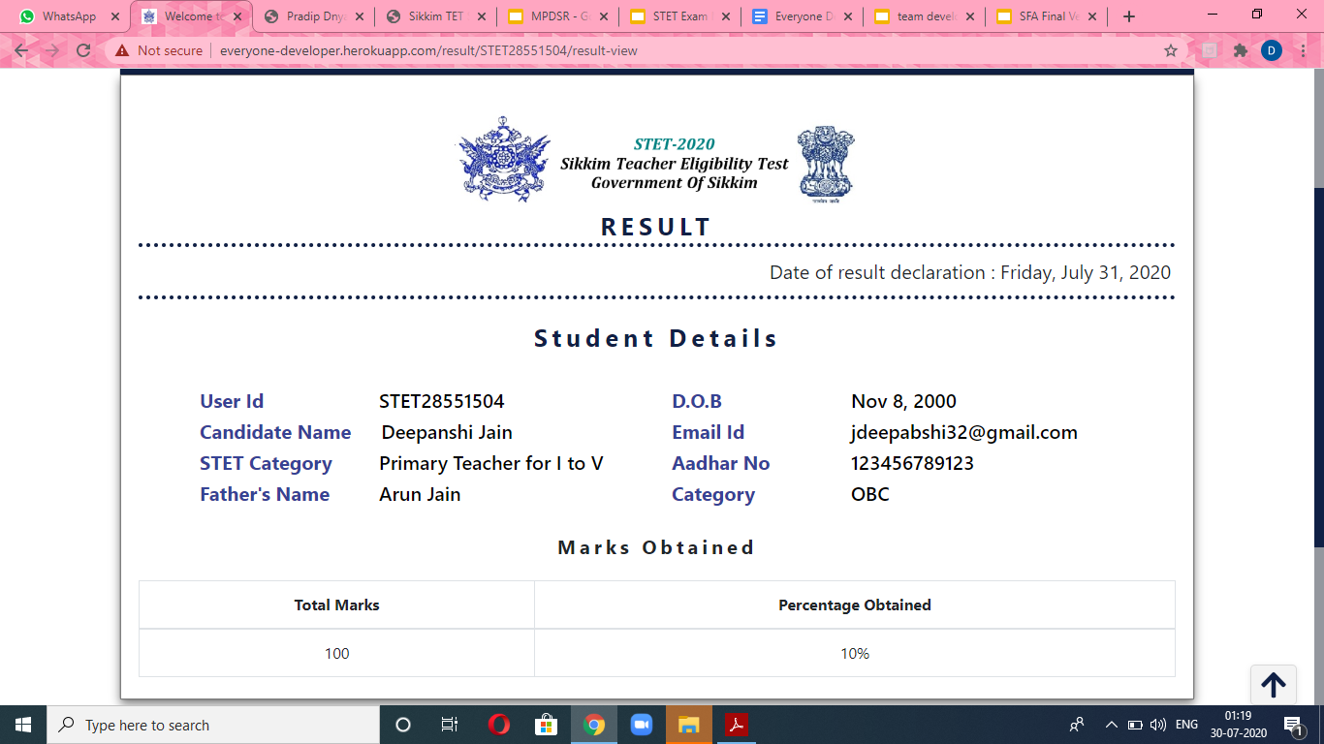
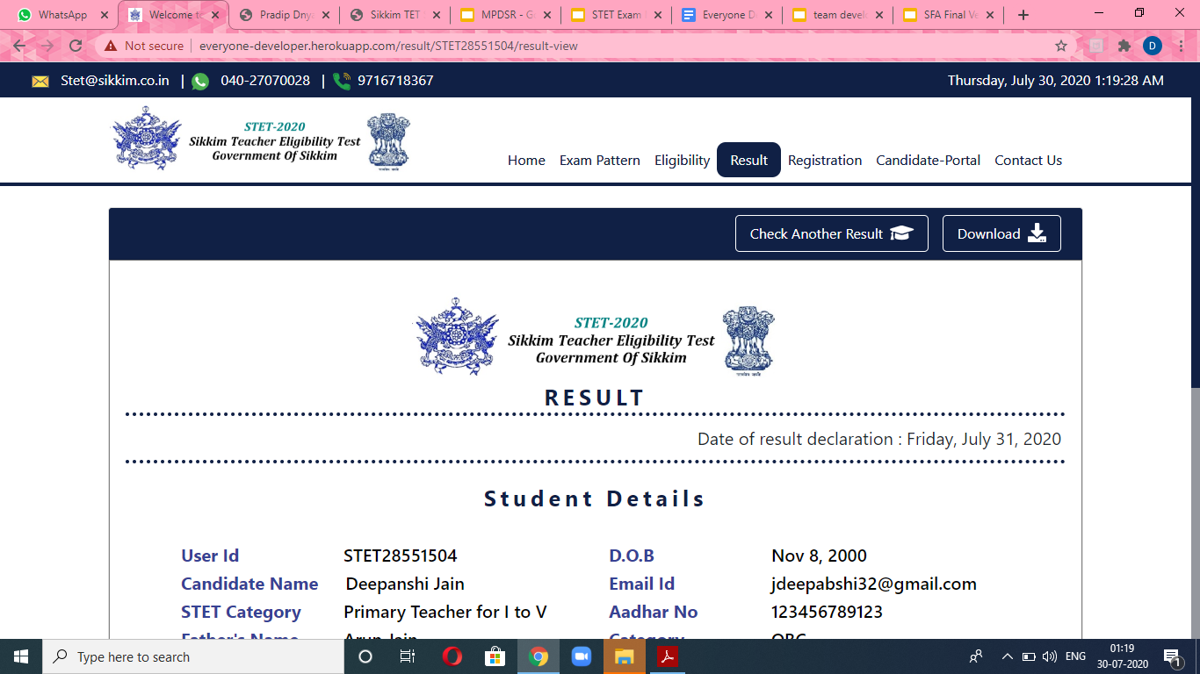
RESULT TEMPLATE
User can check another result by approaching another User Id.
User can download the result in pdf format.

Slide 26
REGISTRATION

Slide 27
STEPS TO DO THE REGISTRATION
REGISTRATION
STEP 1
STEP 2
STEP 3
STEP4
Basic Details
Address Details
Education Details
Image/Upload and Payment

Slide 28
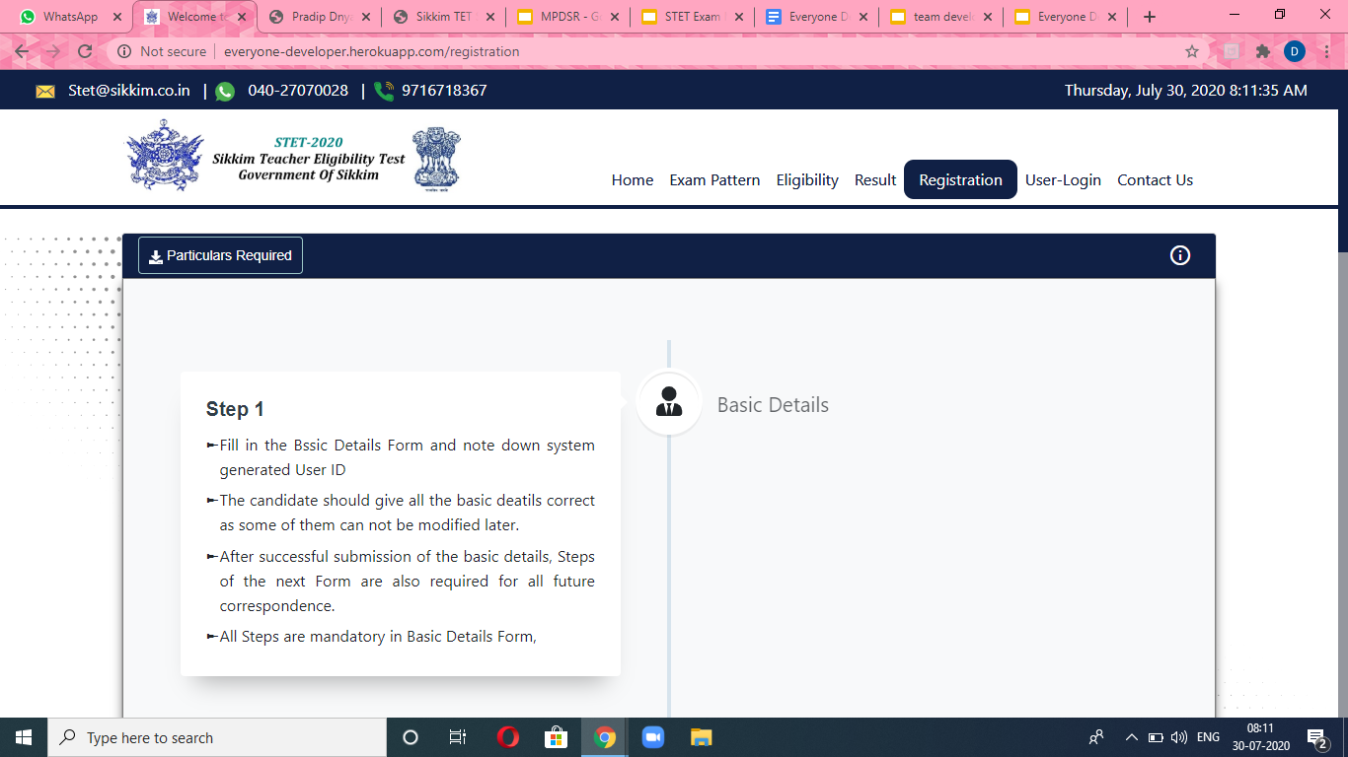
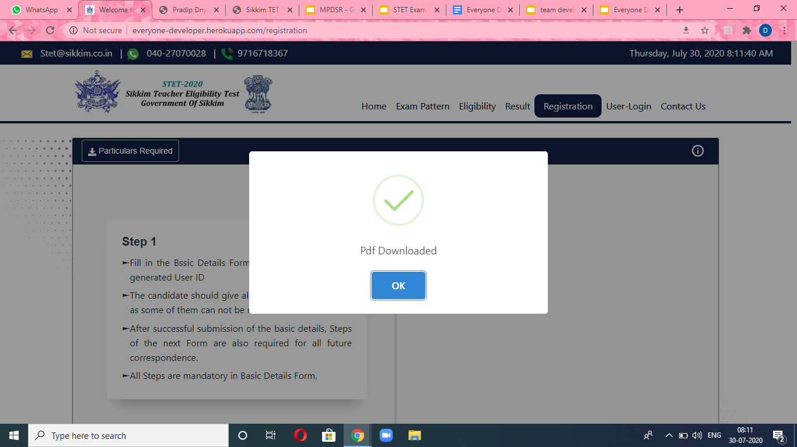
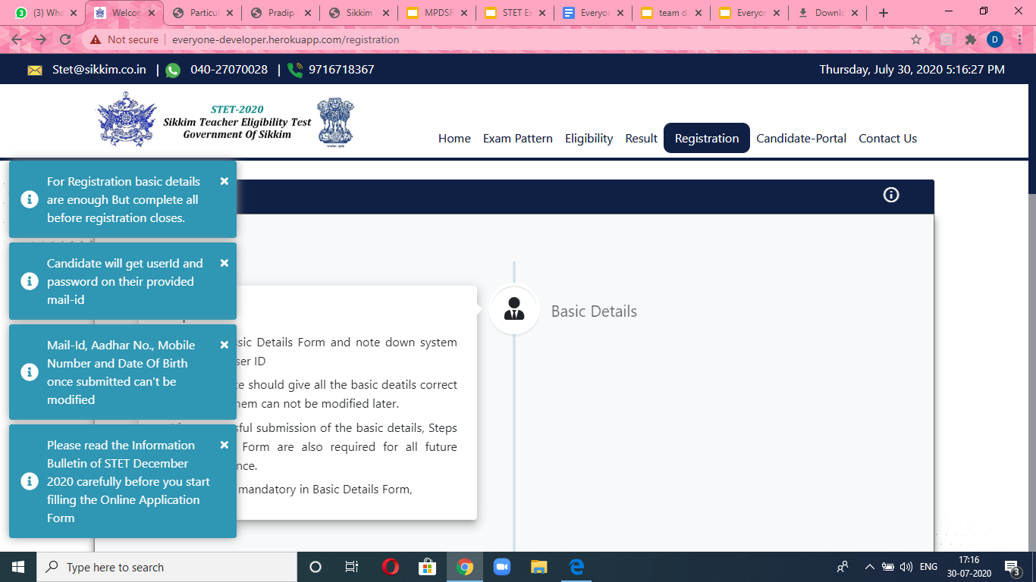
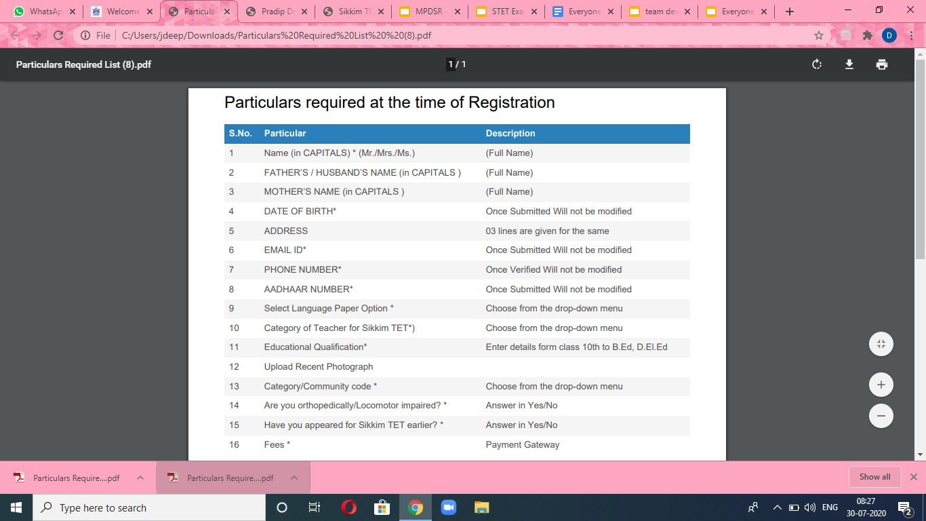
PARTICULARS REQUIRED
HIDE/SHOW INSTRUCTIONS

Slide 29
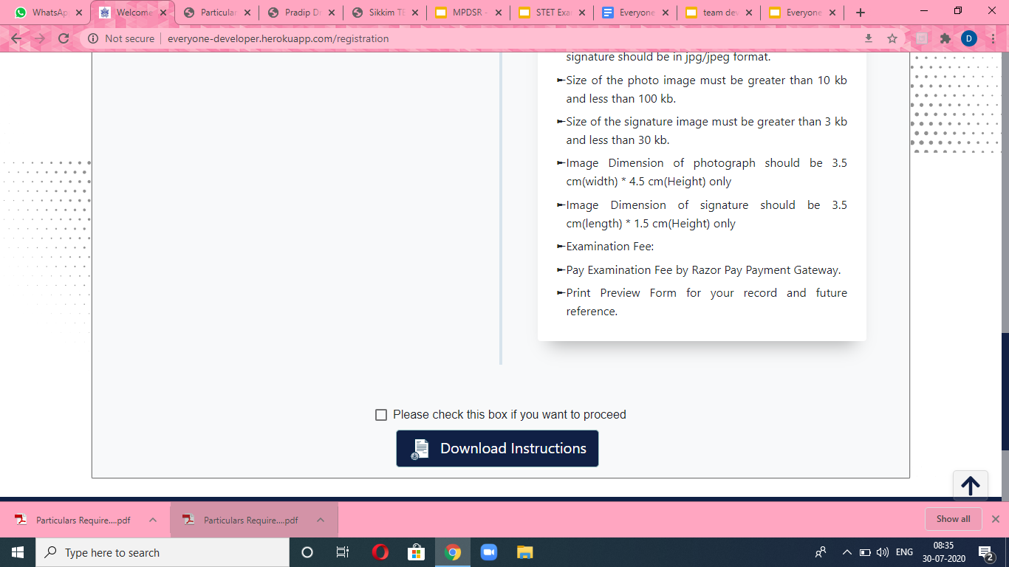
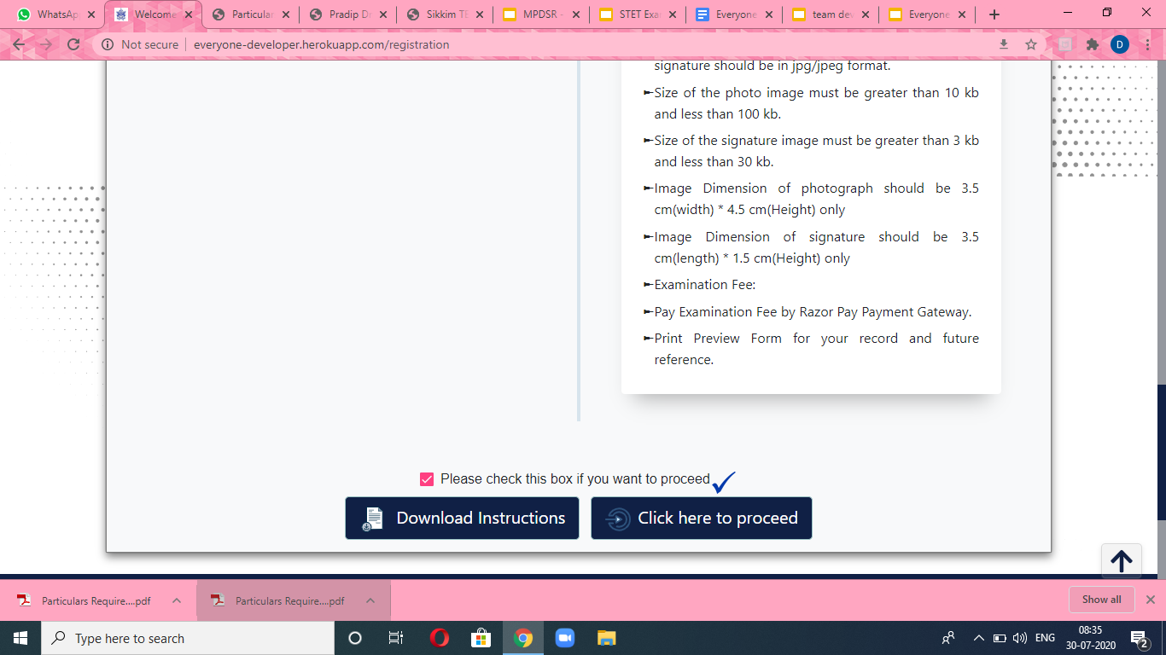
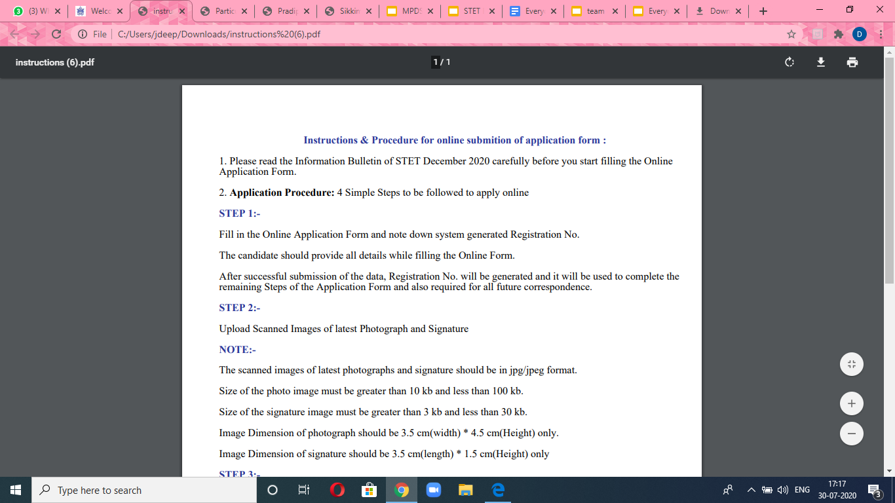
PROCEDURE TO DO THE REGISTRATION
STEP 1 :
STEP 2:
If user wants to download instructions of registration offline in pdf format.
STEP 3:

Slide 30
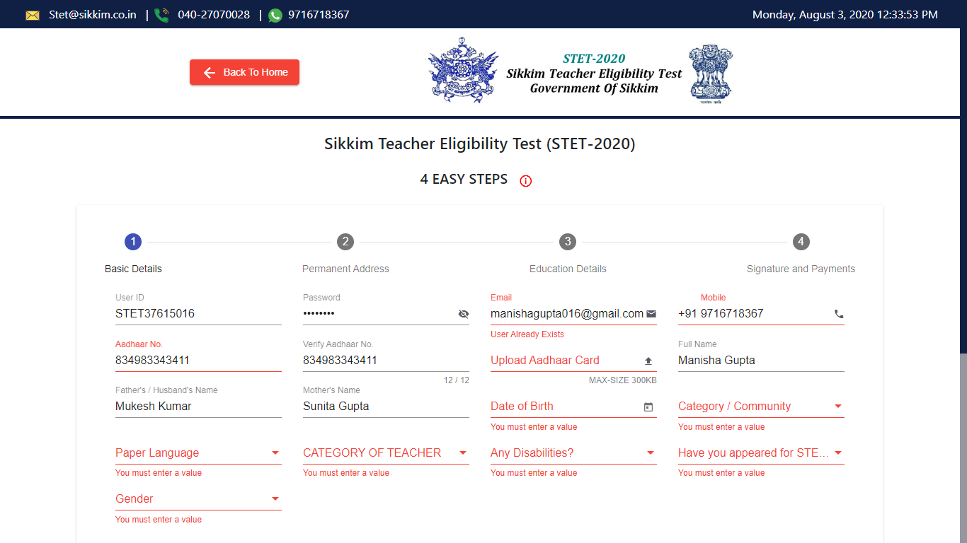
PROCEDURE TO DO THE REGISTRATION
Unique User ID
Two Steps Verification
Unique Mail ID
Upload Aadhar Card in pdf format
Self Explanatory Fields

Slide 31
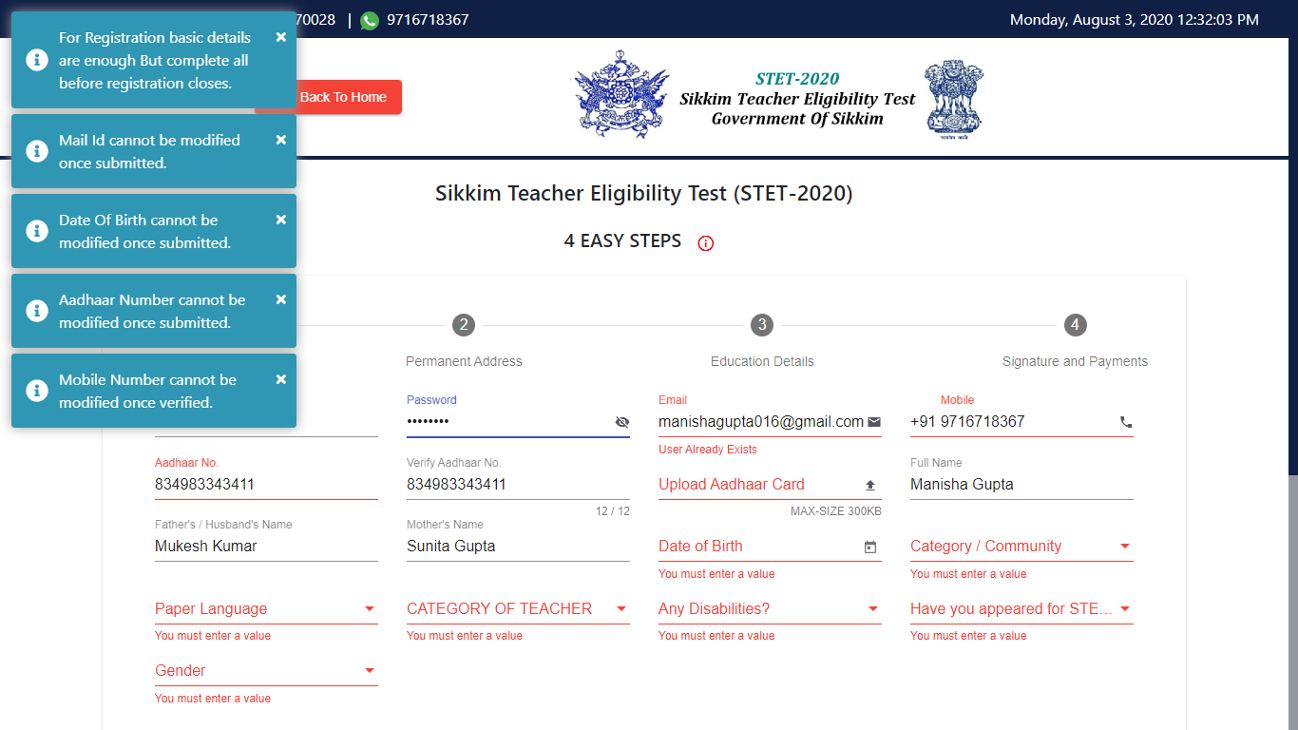
SOME LIMITATIONS DURING REGISTRATION
HIDE/SHOW INSTRUCTIONS
USER WILL CREATE HIS OWN PASSWORD

Slide 32
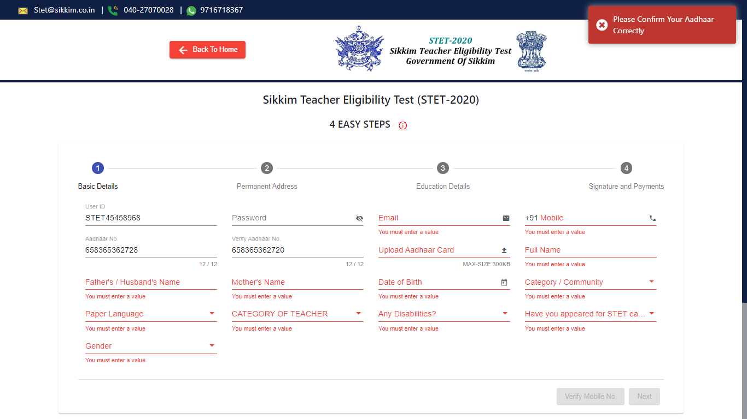
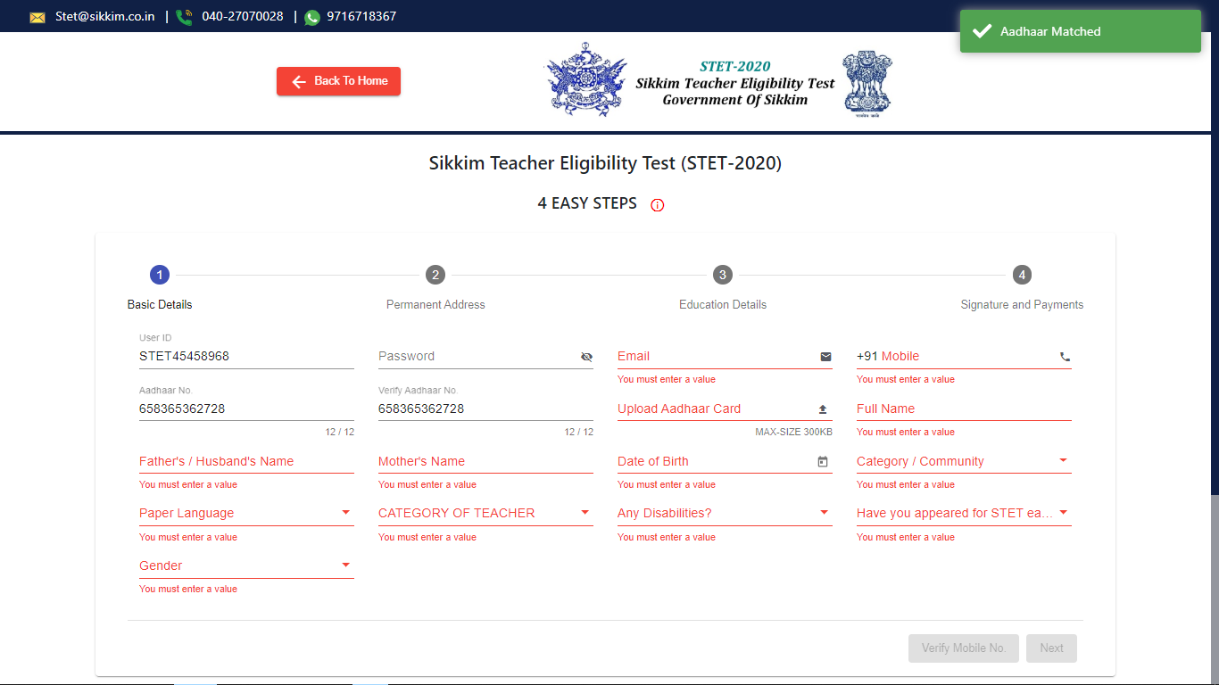
AADHAR VERIFICATION
If Aadhar number does not match
If Aadhar matches

Slide 33
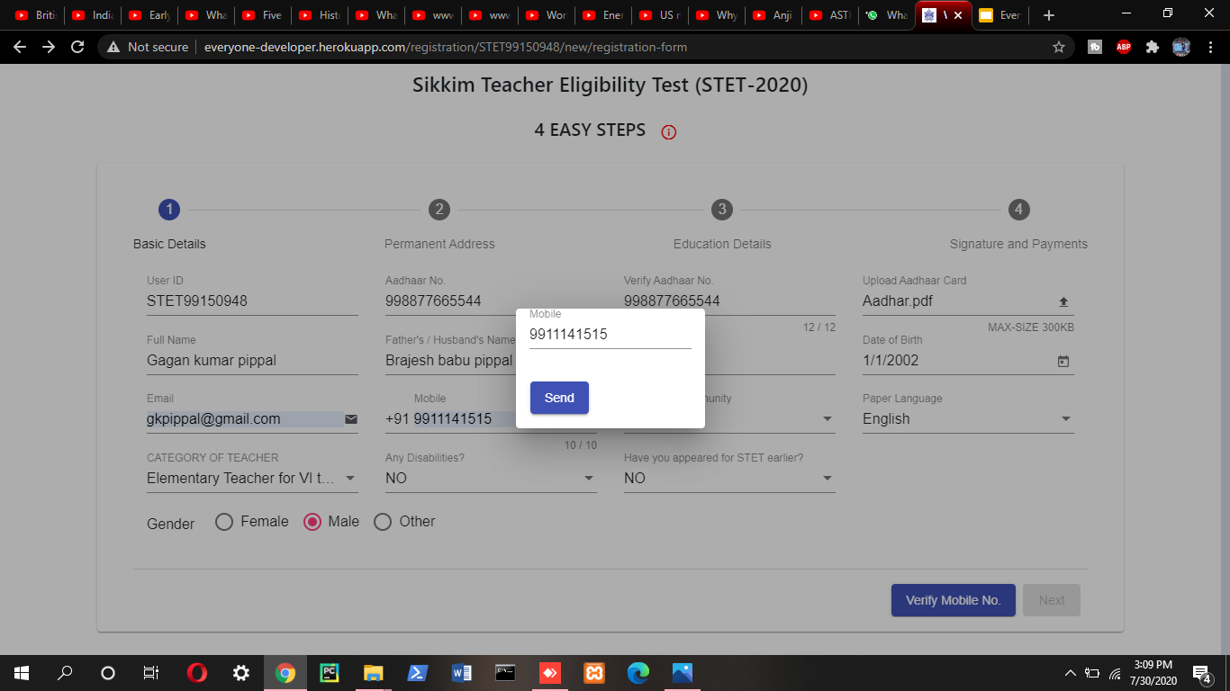
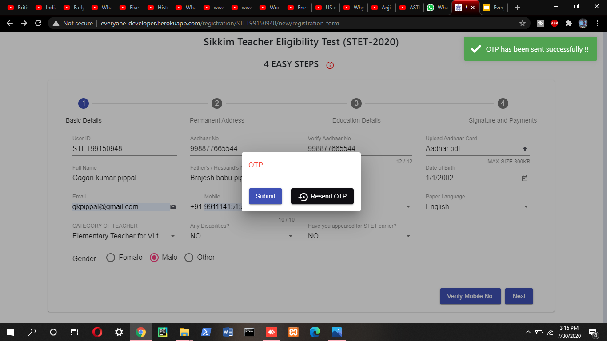
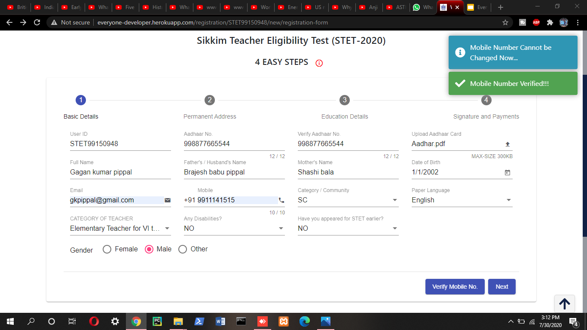
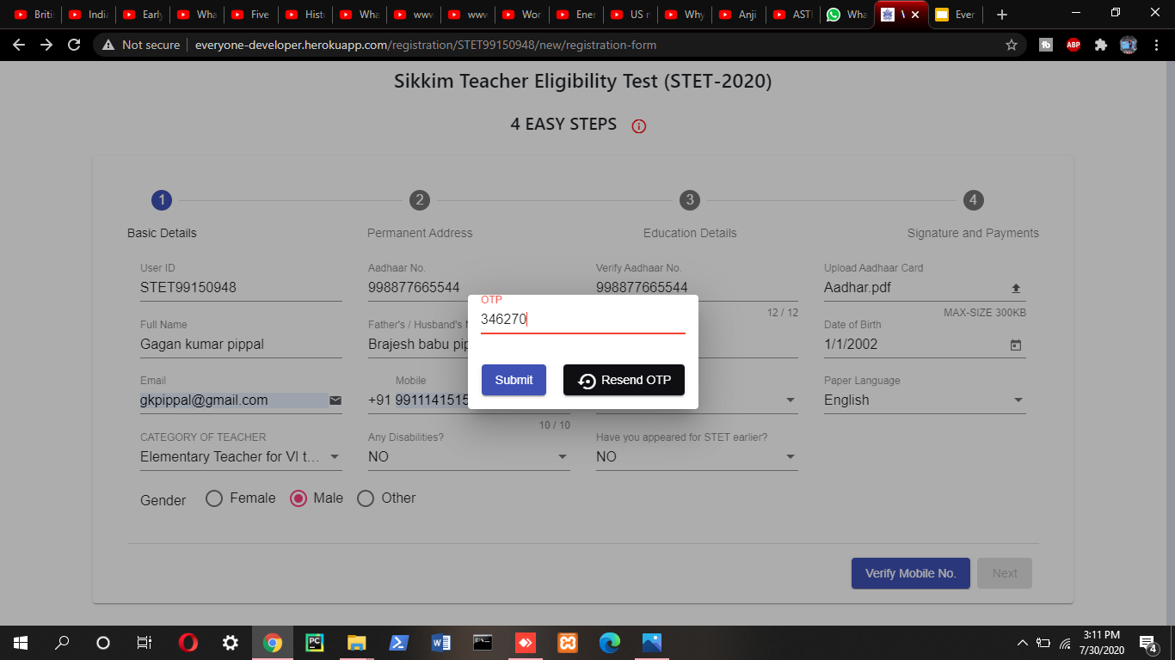
2. VERIFICATION OF PHONE NUMBER

Slide 34
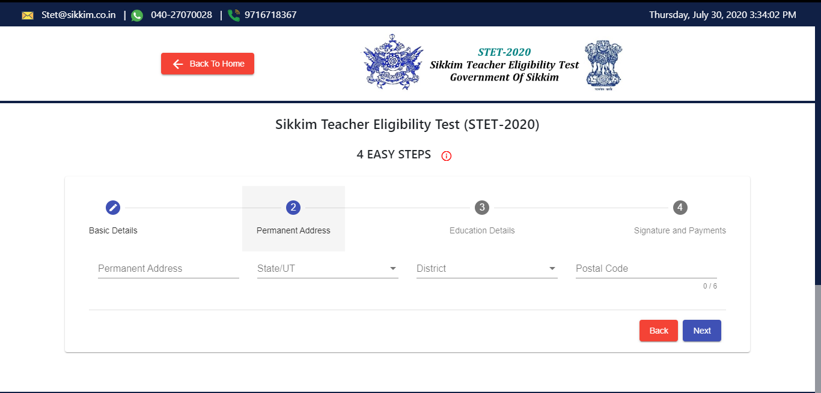
SAMPLE VIEW OF PERMANENT ADDRESS

Slide 35
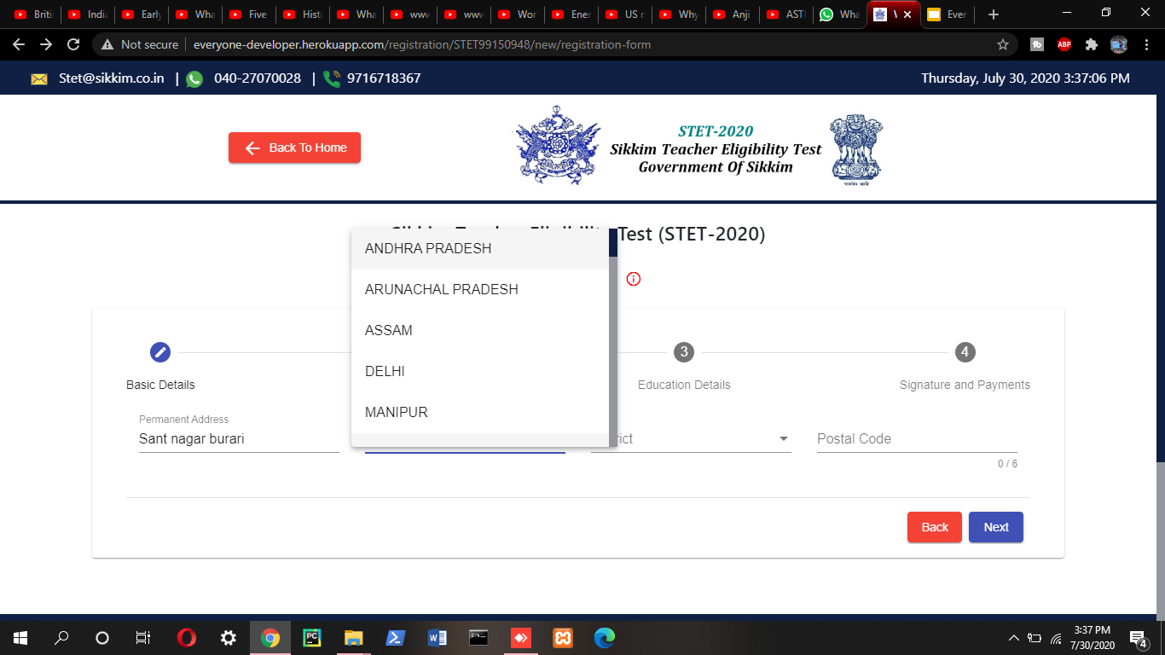
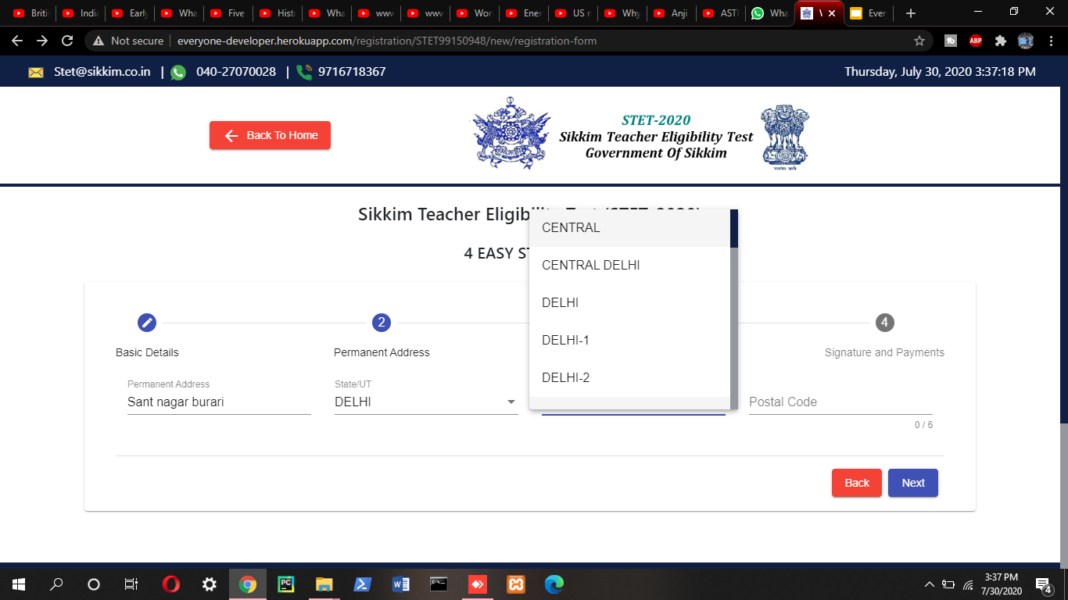
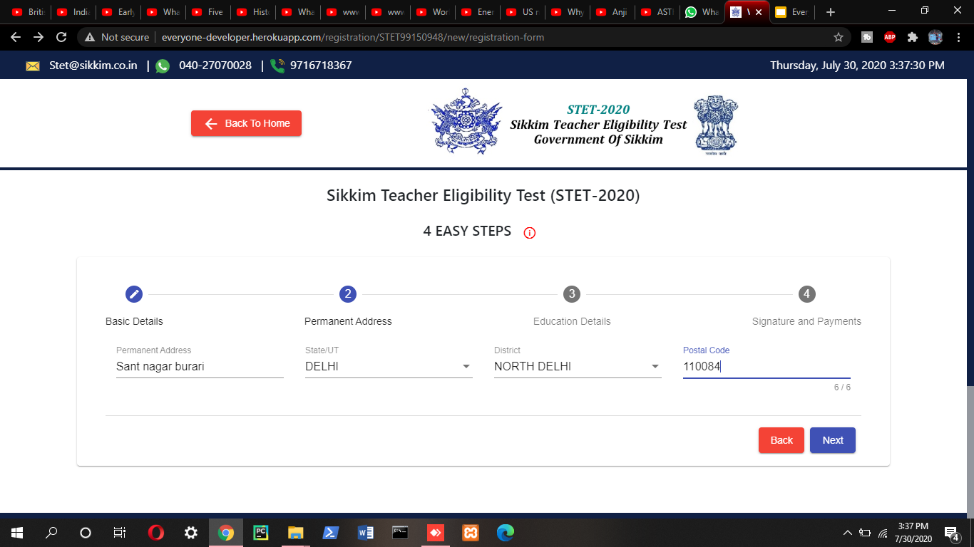
SAMPLE VIEW OF PERMANENT ADDRESS

Slide 36
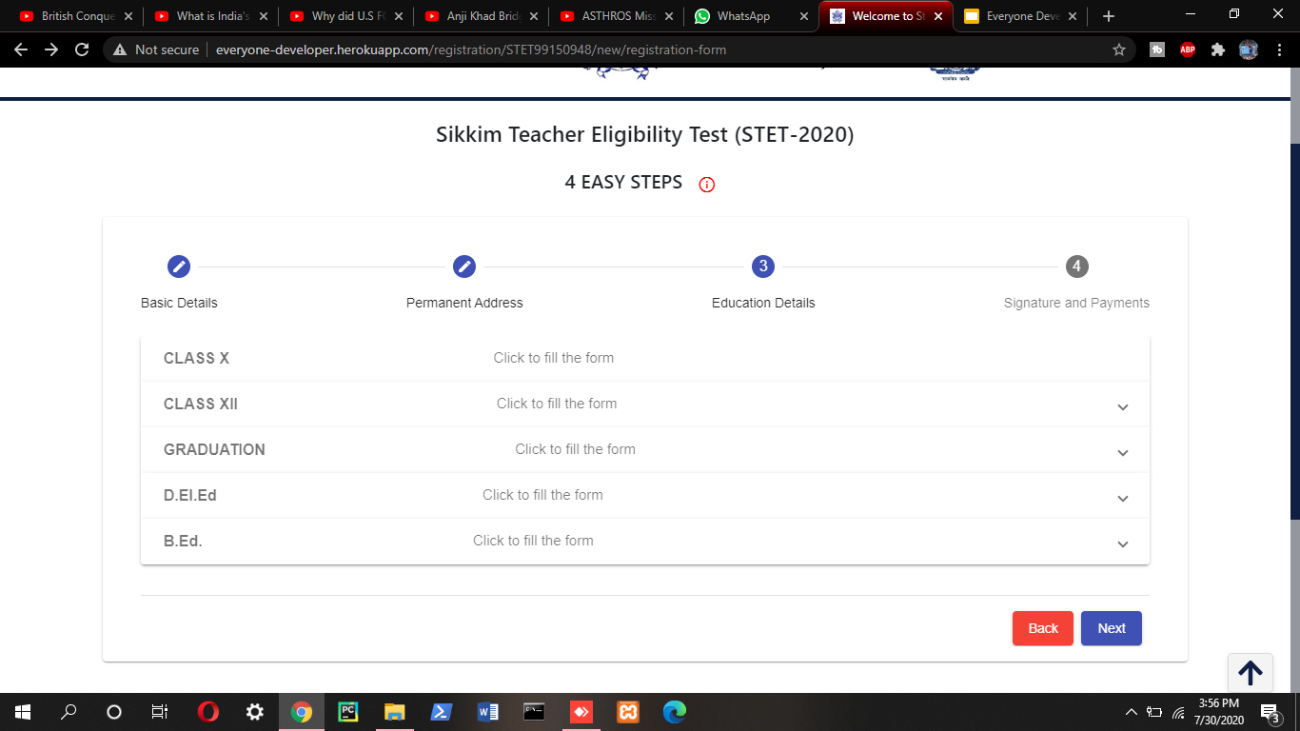
SAMPLE VIEW OF EDUCATION DETAILS

Slide 37
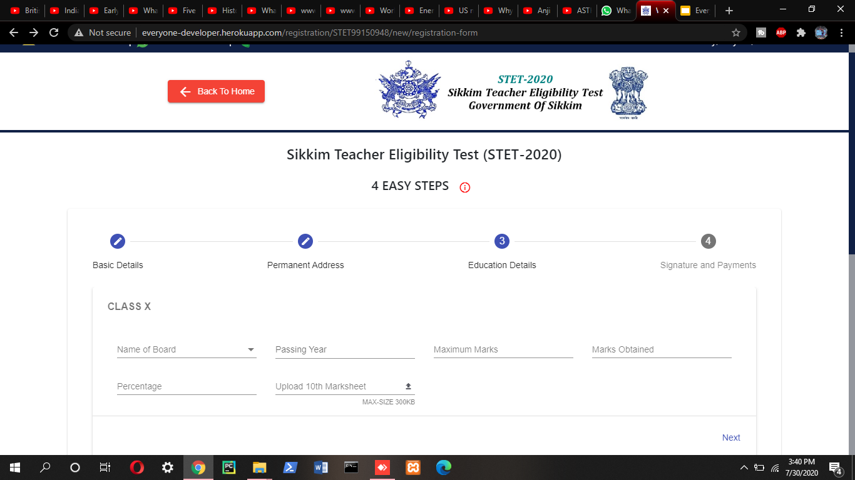
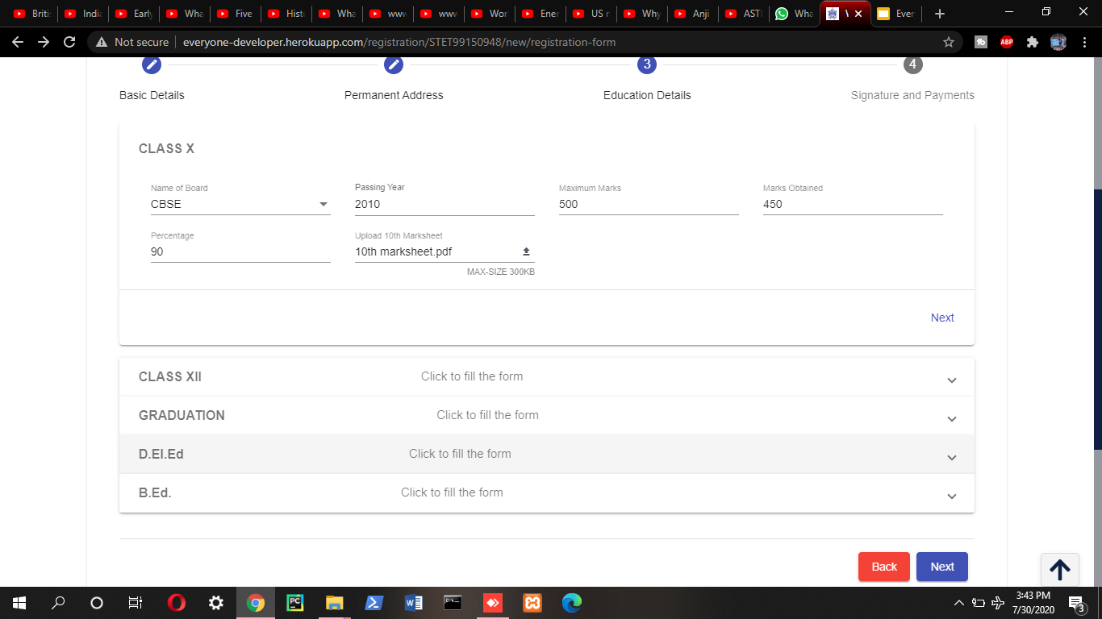
SAMPLE VIEW OF EDUCATION DETAILS

Slide 38
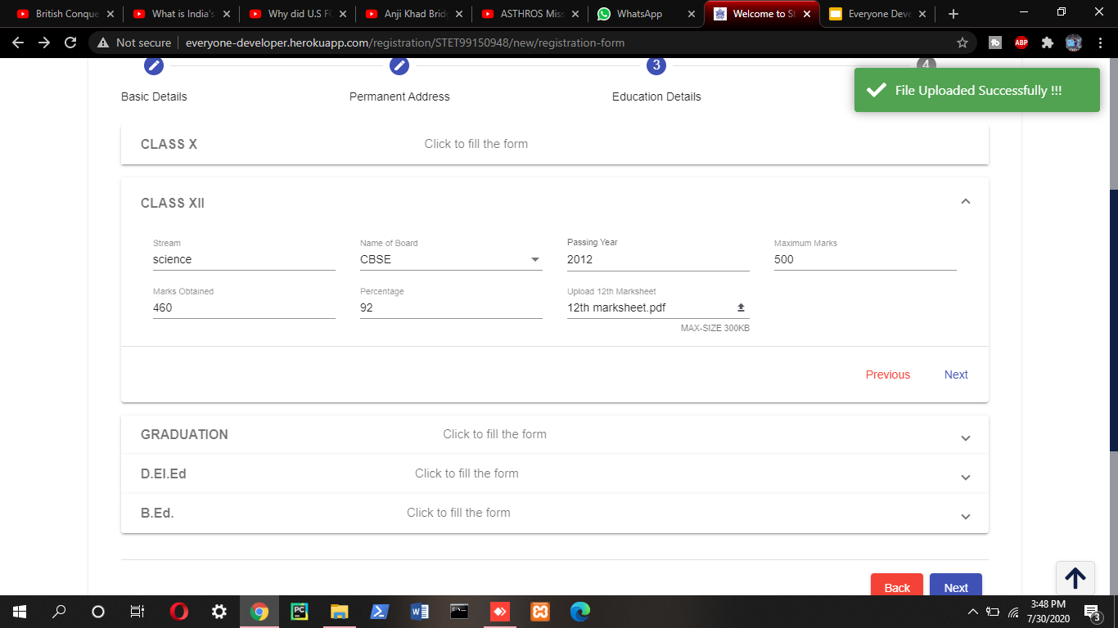
SAMPLE VIEW OF EDUCATION DETAILS
PDF FILE GETS UPLOADED
SAME PROCEDURE FOR OTHERS
CLICK ON NEXT TO PROCEED

Slide 39
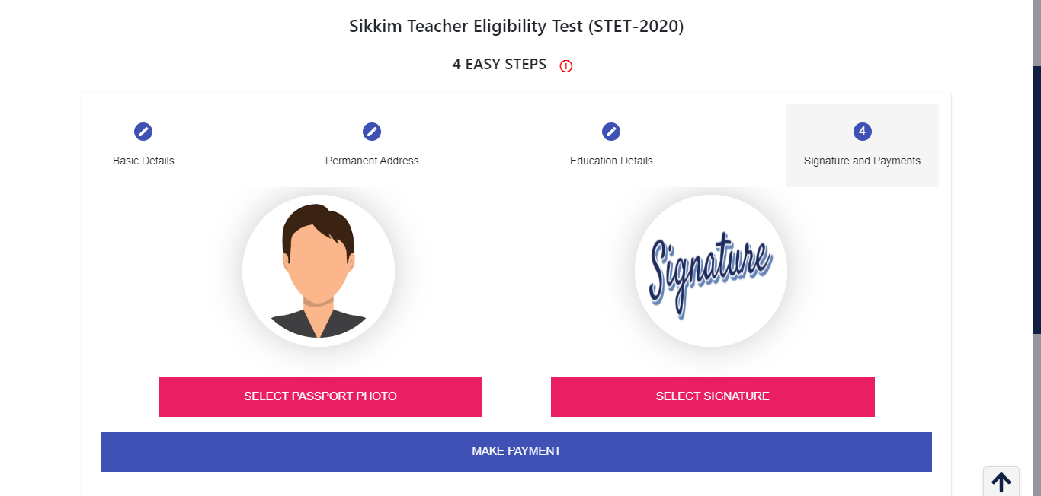
SAMPLE VIEW OF SIGNATURE AND PAYMENTS

Slide 40
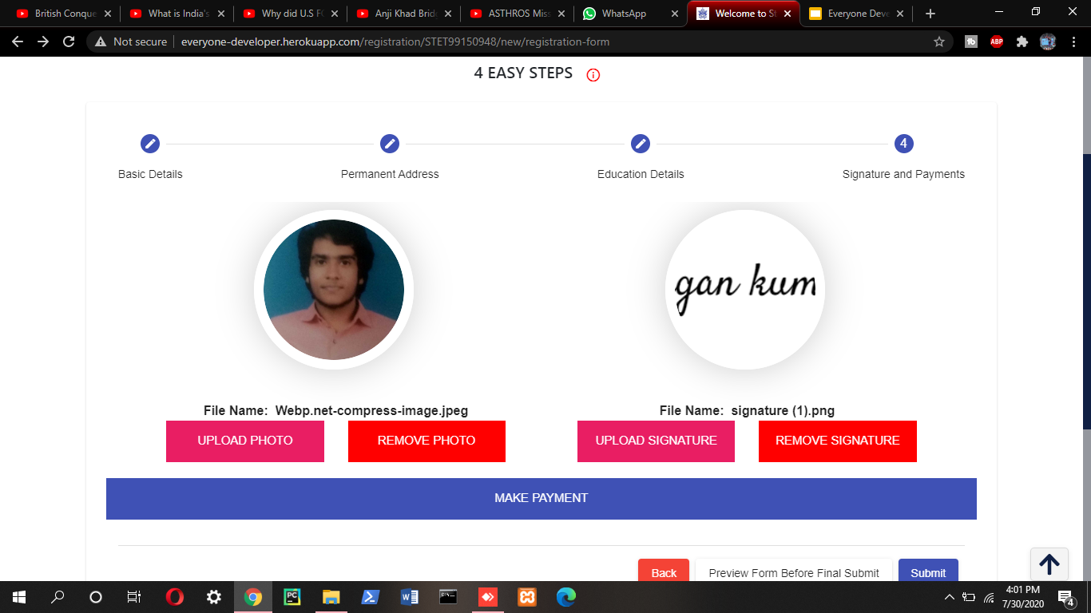
SAMPLE VIEW OF SIGNATURE AND PAYMENTS
PRESS ON THE BUTTON. IF YOU WANT TO REMOVE PHOTO
PREVIEW OF YOUR SELECTED PHOTO
PREVIEW OF YOUR SELECTED SIGNATURE
PRESS ON THE BUTTON. IF YOU WANT TO UPLOAD PHOTO
TO MAKE PAYMENT

Slide 41
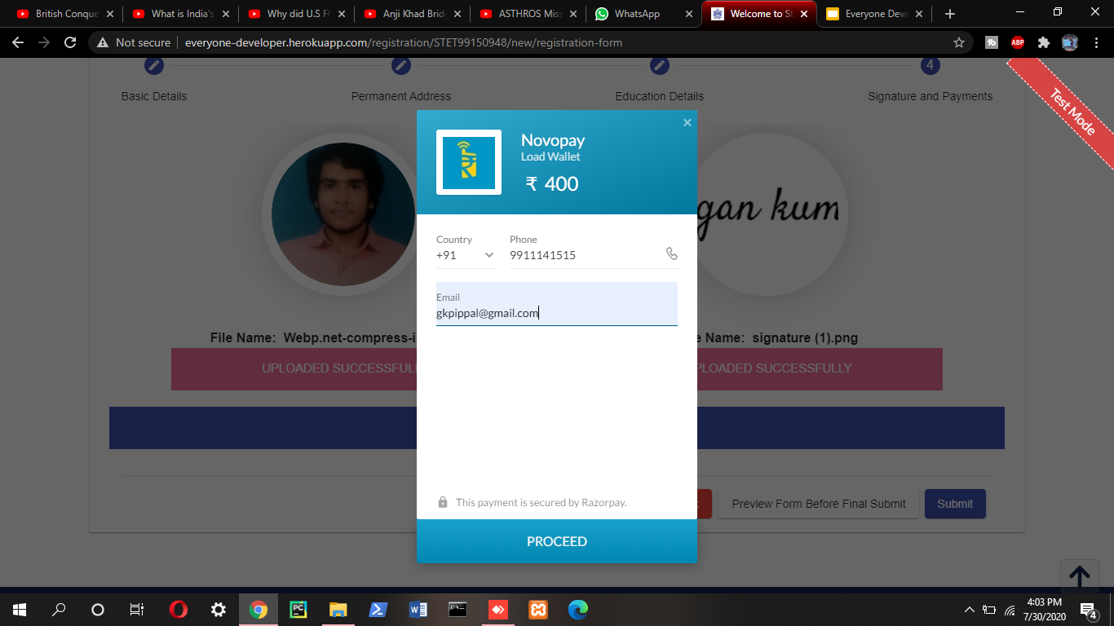
STEPS TO DO PAYMENT
1. ENTER YOUR PHONE NUMBER
2. ENTER YOUR EMAIL ID

Slide 42
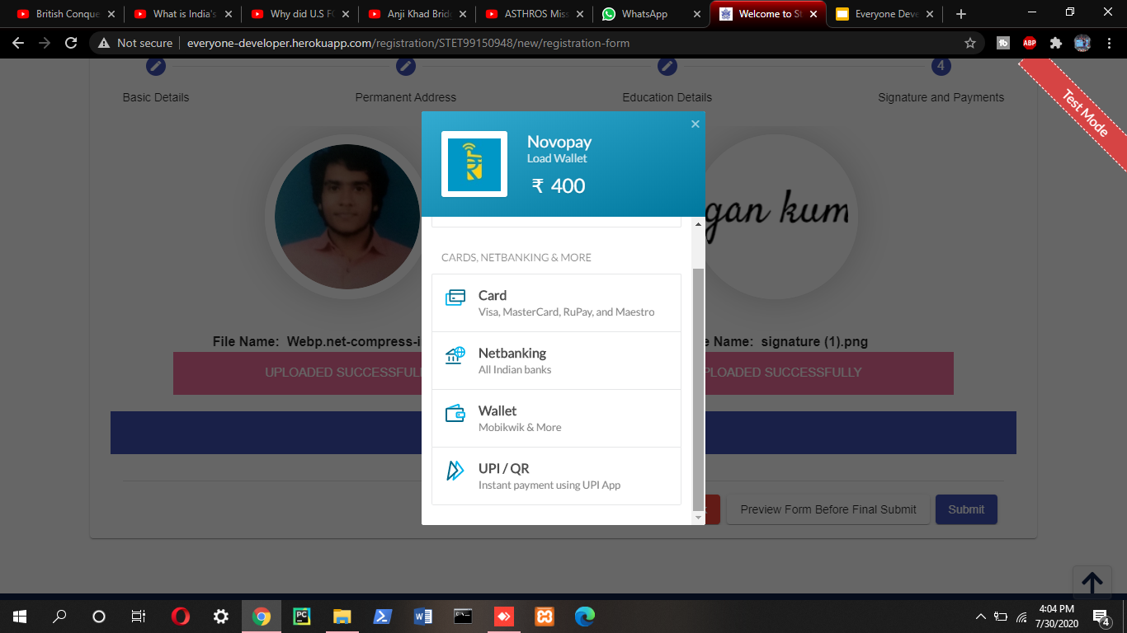
STEPS TO DO PAYMENT

Slide 43


STEPS TO DO PAYMENT

Slide 44


STEPS TO DO PAYMENT

Slide 45


SAMPLE OF PREVIEW BEFORE SUBMITTING FORM

Slide 46


SAMPLE OF PDF AFTER DOWNLOADED

Slide 47


SAMPLE OF ALERT BEFORE SUBMITTING FORM

Slide 48
USER LOGIN

Slide 49

SIGN IN WITH GOOGLE ACCOUNT FACILITY FOR USER

Slide 50

USER-LOGIN
SIGN IN WITH GOOGLE

Slide 51

APPLICATION HISTORY

Slide 52

MY PROFILE

Slide 53

MY PROFILE

Slide 54

MY PROFILE

Slide 55

MY PROFILE

Slide 56


MY PROFILE

Slide 57

MY PROFILE

Slide 58

MY PROFILE

Slide 59

MY PROFILE

Slide 60

MY PROFILE

Slide 61

ADMIT CARD DETAILS

Slide 62

ADMIT CARD ISSUED

Slide 63

PREVIEW OF ADMIT CARD

Slide 64

DOWNLOADING ADMIT CARD

Slide 65

DOWNLOADED PDF OF ADMIT CARD

Slide 66

MODIFICATION IN REGISTRATION

Slide 67

IF MODIFY REGISTRATION IS CLOSED

Slide 68

MODIFICATION IN REGISTRATION

Slide 69


MODIFICATION IN REGISTRATION
CLICK ON THIS BUTTON

Slide 70

RESULT STATUS

Slide 71

RESULT STATUS
DOWNLOAD
RESULT

Slide 72

RESULT STATUS

Slide 73

DOWNLOADING RESULT

Slide 74


CONTACT US

Slide 75


CONTACT US

Slide 76

EXAM CONDUCTION
EXAM BUTTON
EXAM LOGIN

Slide 77


EXAM INSTRUCTIONS
CLICK ON THIS BUTTON TO PROCEED

Slide 78

DEMO ONLINE TEST

Slide 79
NOW SAMPLE OF OUR WEBSITE’S ADMIN PORTAL CONTINUES

Slide 80

ADMIN PORTAL

Slide 81

THEME SETTING
A THEME SETTING BUTTON TO ADJUST THEME.

Slide 82


DASHBOARD
LEAD TO
RAZORPAY DASHBOARD

Slide 83

DASHBOARD

Slide 84

DASHBOARD

Slide 85




REGISTRATION STATUS

Slide 86

EVENT DATE

Slide 87

EVENT DATE

Slide 88


LATEST NEWS

Slide 89



ADDING A LATEST NEWS

Slide 90


EDIT IN LATEST NEWS

Slide 91

MAIL

Slide 92


MAIL VARIATION

Slide 93


MAIL VARIATION

Slide 94

MAIL VARIATION

Slide 95

ENQUIRY HANDLER

Slide 96

GIVING REPLIES TO THE QUERIES

Slide 97




STEPS TO SEND MAIL
Toaster To Show That Mail Has been
Sent Successfully

Slide 98

TOTAL CANDIDATES
ALL DETAILS CAN BE DOWNLOADED IN VARIOUS FORMAT

Slide 99

TOTAL CANDIDATES
IF PAYMENT IS PENDING

Slide 100

TOTAL CANDIDATES
CANDIDATE INFORMATION CAN BE EDITED OR DELETED

Slide 101



STEPS TO UPDATE ANY CANDIDATE

Slide 102

APPROVED CANDIDATES

Slide 103

ISSUING ADMIT CARD

Slide 104

CUT OFF

Slide 105


UPDATING CUT OFF

Slide 106

PREVIEW OF UPDATED CUT OFF

Slide 107

RESULTS

Slide 108


SAMPLE OF UPLOADING RESULTS

Slide 109

SAMPLE OF UPLOADED RESULTS

Slide 110


SAMPLE OF FILTERING RESULTS

Slide 111

EXAM HANDLER

Slide 112

EXAM HANDLER

Slide 113


ADMIN PROFILE

Slide 114




UPDATION IN ADMIN PROFILE

Slide 115
NOW SAMPLE OF OUR STET APP CONTINUES

Slide 116

STET MOBILE APP

Slide 117


STET APP VIEW

Slide 118
SAMPLE VIEW OF HAMBURGER

Slide 119



HOME

Slide 120

LATEST INFORMATIONS

Slide 121


EXAM PATTERN

Slide 122


SYLLABUS FOR PAPER 1

Slide 123


SYLLABUS FOR PAPER 2

Slide 124


ELIGIBILITY

Slide 125


APPLY

Slide 126



LOGIN

Slide 127



REGISTRATION

Slide 128

REGISTRATION ON WEBSITE
ON CLICK, REDIRECTED TO WEBSITE

Slide 129



RESULT NOT ANNOUNCED

Slide 130


RESULT ANNOUNCED

Slide 131


FAQ

Slide 132


HELPLINE/CONTACT

Slide 133


